Slide 1

CONFIDENTIAL
Project Hestia
Digital Due Diligence

Slide 2
DISCLAIMER
In accordance with our agreement on our proposal dates as of May 17th, 2021 (the “Agreement”) between Apax partners (the “Client”) and eleven Strategy Consultants (“eleven”), we attach our report related to the digital strategic buyer due diligence of Hestia.
This document is confidential. It has been prepared by eleven for the sole use of the parties to whom it is addressed. Eleven will accept no liability or responsibility to any person other than the Client and then only as referred to in the Agreement. Eleven does not provide legal, accounting or tax advice. Client is responsible for obtaining independent advice concerning these matters, which advice may affect the guidance given by eleven.
The analyses and conclusions contained in this report were concluded within one-week period from May 17th, 2021.
The report is based upon information obtained from the Client and from other sources deemed to be reliable. Market analyses and projections represent eleven’s judgment, based upon data sources cited, and are subject to the validity of the assumptions noted herein.
For purposes of the analyses presented in this report, eleven has relied upon, and considered accurate and complete data obtained from the Client and its advisers, publicly available information, interviews with clients, competitors of the Group as well as market experts. Eleven has not independently verified the completeness or accuracy of that data and assumes no responsibility for it. No representation or claim is made that the results projected will actually be achieved.
It is expected that the recipient will conduct its own independent analysis. All estimates and projections contained in this report are based on data obtained from the sources cited and involve significant elements of subjective judgment and analysis, which may or may not be correct.
Eleven has made no undertaking to update these materials after the dates cited in the Agreement.

Slide 3
Both external expert interviews and reference materials coming from internal and external sources have been leveraged throughout eleven’s analyses
Expert interviews conducted by eleven*
Industry reports and other data sources
Xavier Gazay – CEO at Sedgwick France Sas. (4/2020-present)
Henri Laurent – Former Director of Board at Grupo Multiasistencia (4/2016-12/2019)
Benoit Grondin – Former CMO at Travaux.com (3/2014-1/2021)
Antoine Bagnaninchi – Former Business Developer at Frizbiz (09/2019 - 05/2020)
Joffrey Moret - Home Product Manager at Allianz Partners Sas (4/2018-present)
Materials provided by APAX as part of process:
VDD Hestia (Advention)
Info. Memo. Hestia
Other reference materials:
CED Whitepaper on Repair in kind
Les plateformes numériques dans le bâtiment – Etat des lieux & enjeux, Fédération Française du bâtiment
*GLG contacts
Interview done

Slide 4
Glossary of key terms
ACRONYM
TERM
DESCRIPTION
API
Application Programming Interface
Interface that defines interactions between multiple software applications
CEREN
n.a.
Dedicated structure to handle file management
CRM
Customer Relationship Management
Process in which a business or other organization administers its interactions with customers
DIY
Do-it-yourself
Method of building, modifying or repairing things by themselves without the direct aid of experts or professionals
EDI
Electronic data interchange / échange de données informatiques
Computer-to-computer exchange of business documents in a standard electronic format between business partners
ERP
Enterprise Resource Planning
Category of business management software, typically a suite of integrated applications
GED
“Gestion électronique des documents” / Document Management system
System used to receive, track, manage and store documents online
IARD
Incendies, Accidents et Risques Divers
IRD
Incendies et Risques Divers
NPS
Net Promoter Score
Metrics on likelihood to recommend a company, product or a service to a friend or a colleague
REN
“Réparation en nature” / Repair-in-kind
The insurer takes charge of all actions to be carried out in order to repair damage
VA
Vitale Assistance

Slide 5
Executive summary
1
Page 6
Outside-in assessment of Hestia’s digital projects
2
Page 23
AGENDA
Risk/opportunity analysis of platform business models
3
Page 51
Appendix
4
Page 74

Slide 6
Executive summary
1
Outside-in assessment of internal digital projects
2
AGENDA
Risk/opportunity analysis of platform business models
3
Appendix
4

Slide 7












In the key moment of the claim within customer relationship, the repair-in-kind market revolves around a complex ecosystem– with an increasing need for transparency, communication and operational efficiency
1
1. Digital projects’ assessment
Simplified repair-in-kind ecosystem
Beneficiaries
Beneficiaries require a digitalized process to handle their claim and the possibility to follow-up the claim settlement process, reinforcing the need for REN providers to develop digital tools
Demand side
Insurers
…
Post loss stakeholders
Repair-in-kind market evolve in a complex ecosystem, with a significant number of stakeholders (beneficiaries, insurers, REN providers, professionals) where digital appears as an opportunity to deliver premium services
Expertise companies
REN providers
Integrated model
Non-integrated model
Hestia
…
…
Market penetration: 17.5% (excl. natural disasters) with an estimated CAGR of 6% until 2025
Coverage: 100% of approved providers
…
Digital tools represent a strong lever of differentiation for Hestia and its peers in their relationship with insurers, beneficiaries and the professionals employed or external for a global enhanced experience
Professionals
Supply side
Employed professionals
External professionals
Sources: eleven research and analysis

Slide 8









REN providers are facing multiple customer expectations, on the part of insurers and insured end-clients, such as providing an end-to-end management of the claim
1
1. Digital projects’ assessment
Receipt of the mission order
Phase
Stakeholders involved
Global Process (post-claim reparation)
Market expectations / key stakes for post loss players
Contact with the insured
Upstream, facing the insurance company
Insurance companies expect a system that simplifies the handling of claim file and provides them with an end-to-end management
“Insurance companies are looking for end-to-end claim management with a REN provider handling all the process.”
– Home Product Manager at Allianz Partners
Pre-repair visit
Drafting of the quotation
“The REN providers do not win money on repair (perhaps on the volume) but win money on workflow management.”
– Home Product Manager at Allianz Partners
Design office control
End customer require a better access with a digital platform to follow their claim, as demonstrated by a survey conducted by Multiasistencia where 58% of insured people place digitalization as their top priority
Sending of the quotation
Internal (For the contractor
/worker)
“For all insurance companies, it is very hard to find skilled workers where you can be confident about the quality of their work.”
– Home Product Manager at Allianz Partners
Agreement and planning
Reparation
“The REN providers have two ways to differentiate themselves: the service delivered through digital tools or the quality of the repair.”
– CEO at Sedgwick
Signature and doc. receipt
Insurance companies trust REN providers to deliver top quality interventions (by meeting deadlines, adequate matching)
Quality control, client satisfaction
“REN provider need to use their long-lasting data base to create management rules to increase both the margin and customer satisfaction.”
– Home Product Manager at Allianz Partners
Down-stream, end-customer facing
After reparation
Non-claim situations
Market stakeholders are looking for decision-support tools with key aspects:
Price evaluation
Repair follow-up
“REN providers could provide tools for automated decision-making to offer the most advantageous choice to the insurance company.”
– Home Product Manager at Allianz Partners
Non-core
Sources: eleven research and analysis, expert calls
Insurers
Repair stakeholders
Insured people

Slide 9

These client expectations result in precise use-cases along the value chain, where repair-in-kind players could differentiate themselves
1
1. Digital projects’ assessment
Receipt of the mission order
Phase
Stakeholders involved
Global Process (post-claim reparation)
Identified use-cases for a company such as Hestia
Contact with the insured
Upstream, facing the insurance company
1
Declaration of the claim and assistance in case of need
5
Workers sourcing and validation for REN providers’ network
Workflow management
Centralization of information for a given subject (API, ERP, 360° file overview, mail integration)
Pre-repair visit
Management of repairers : KPI dashboards, contract management tool, webinars, mobile app
First-time-right intake : assignment profiling through tele advice
Assignment repairer fit : assignment matching on skills ➔ capability database, matching algorithm, dynamic planning tool
Quality monitoring : review systems
Quality control : data pattern analysis
Drafting of the quotation
2
6
Seamless reporting advancement and follow-up through online portal
Loss data collection (visio, selfcare, drones)
11
Claim reporting and first draft of the quotation
Design office control
7
Optimization of claim analysis process, draft of quotation and price setting
Sending of the quotation
12
Easy and quick validation step and follow-up by insurance company / other stakeholders (experts…)
Internal (For the contractor
/worker)
8
Agreement and planning
Optimization of resource planning : assignment repairer fit, dynamic planning tool…
Reparation
13
9
Security and authentication (electronic signature for all stakeholders,…)
Monitoring of staff efficiency & tools during intervention (fraud…)
Signature and doc. receipt
10
14
Quality control, client satisfaction
Operation quality control (repair evaluation)
Repairs’ reporting advancement and final documents received and stored with GED
Down-stream, end-customer facing
After reparation
3
Enhancement of selfcare journey (chatbots, voicebot, Q&A, etc.)
15
Non-claim situations
4
New cross-sell opportunities with existing clients
Finalization and clients’ feedback on the service quality
Non-core
Design services
Other : Invoicing, capability data base of repairers…
Pro-active maintenance tools
Legend
Workflow management
Operations’ efficiency
Client-facing services
Sources: eleven research and analysis, Hestia’s IM
More details in core document
Notes:
Vision structurée de tous les devis, ensemble des claims en cours, first draft…

Slide 10
A first priorization of these use-cases can be carried out, depending on their complexity (capabilities, distance from core business) and their impact for repair-in-kind players, showing two priority clusters
1
1. Digital projects’ assessment
Mapping of use-cases
High impact
Priority 2: Could-have
High impact, requiring investment and capabilities
Priority 1: Must-have, use-cases to master
Nice to have
Low impact
Complex (interfacing, skills required, investments…)
Simple (build-up…)
More details in core document
Legend
Workflow management
Operations’ efficiency
Client-facing services
Sources: eleven research and analysis

Slide 11
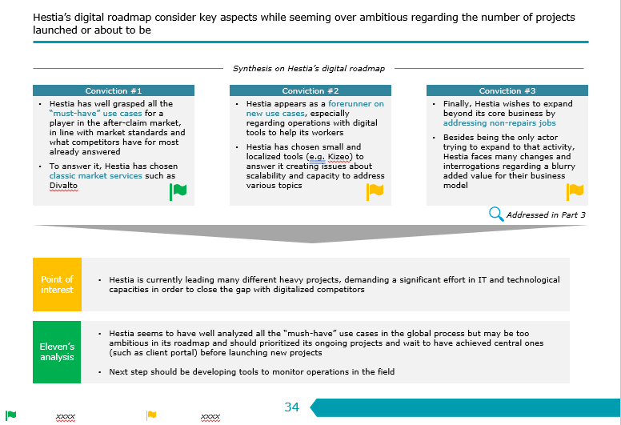

















Hestia demonstrates significant ambition by covering main use-cases, yet few are fully deployed to date
1
1. Digital projects’ assessment
Hestia’s answer to key use-cases
Priority 2: Could have. High impact, requiring investment and capabilities
Priority 1: Must-have, use-cases to master
Hestia’s answer
Use-case coverage
Status
Hestia’s answer
Use-case coverage
Status
Hestia has well grasped all the “must-have” use cases, in line with market standards and what competitors have for most already answered ; yet still in deployment or in spec phase
Facing the issue of scalability with the use of small and localized tools (Mobiloutils), the question of integrating these different solutions together seems essential and must be addressed in further analysis
Work in progress
Priority 1: Must-have, use-cases to master
Work in progress
Work in progress
Work in progress
Spec. phase
Work in progress
Not started
CEREN
Prodapps
Spec phase
Priority 2: High impact, requiring investment and capabilities
Hestia addresses most of use cases, with low complexity yet effective tools and projects, adapted to its level of digital maturity
Many questions remain undetermined with the Prodapps project not yet launched
Deployed
Deployed
Nice to have
Complementary projects to core business could help promote cross-selling opportunities but the model is still to be explored, particularly in view of insurers’ needs (integration in client portal? Commission-based? ...)
Question mark
Further DD assessment: what organization to deliver these projects in the 3 BUs? What integration with existing tools?
Hestia’s answer
Use-case coverage
Status
Under study
NB: Hestia’s answer with Frizbiz will be addressed in the following section
More details in core document
Sources: eleven research and analysis, Hestia’s VDD, Hestia’s IM
Internal solutions
Notes:
Rationnel :
GoVisio : solution interne qui a l’air d’adresser le use case
Kizeo : rédaction de rapports de recherche de fuite
Proad apps : on sait pas ce qu’il y a dedans
Mobiloutils : outil nomade de chiffrage, qui a l’air peu user friendly / très logiciel d’ancien temps

Slide 12










Digital maturity seems to be a key factor in the growth of market players and in the consolidation of competitive position, especially when they reach a critical size through peers’ acquisitions
1
1. Digital projects’ assessment
Hestia and peers’ positioning according to their digital maturity
Comments
Fully digitalized
Digital appears to be a prerogative of the best for it helps major companies to strengthen their position in the competitive landscape and to grow significantly allowing them to make differentiating investments
2
1
1
Best-in-class players have started their digitalization several years ago, with the objective of offering a 100% digitalized and omnichannel experience to insurers and insured customers
Digital maturity
2
4
3
Digital early adopters have relied on digitalization in the first place, rather than acquiring other companies to support their growth
Hestia
3
Increasingly digitalizing players are catching up with market standards, in terms of process and industrialization, while innovating on some distinct projects
Impractical area
Few digital initiatives
4
Traditional players with little digitalization have remained in their historical business without investing in technologies, partnerships or building customer-first solutions
Localized or minority players
Competitors’ size (including international presence)
International players or market leaders
Key Take-aways
Hestia faces two challenges in the coming years: first to finalize its digital transformation to integrate all companies under the group and then to digitalize its operational tools to compete against international players and market leaders
More details in core document
Sources: eleven research and analysis, expert calls

Slide 13









Peers / Competitors – Multiasistencia Multiasistencia has chosen to focus on digital early on and provide a set of self-managing and personalized solutions to the customer, by automating its workflow
1
1. Digital projects’ assessment
Multiasistencia digital chronology
Digital tool –Voicebot
Focus on digital solution for operational efficiency
New digital channel that allows end-users to communicate and interact during the management of their claim
Macarena, an AI voicebot for a fully automated home claims FNOL and steering
Introduced in February 2019, Macarena is the first voicebot capable of handling a claim repair all the way without any human assistance other than the repair itself
2014
2015
2016
2017
2019
Replaces an agent from the call center, available 24/7
Renewal of SysteMA (technology platform to improve the performance, power, adaptability and safety of systems)
Birth of Digital Solutions to improve the claim management process
Identifies more than 1,300 combination of cause and damages
Schedules an appointment for claim reparation
Verifies craftsman’s arrival on site
Handles the closing of the claim file directly
Between January and August 2020, Macarana answered 500,000 calls and could resolve 30% of claims without human assistance.
More generally, being connected to sMArt (digital solutions) it automizes 86% of files registration
“The development of a digital platform was a strategic issue and a potential business opportunity, so it was necessary to develop it ourselves. Today it is even sold to some of its competitors.”
– Former Director of Board at Multiasistencia
Key Take-aways
Multiasistencia’s solutions allow to customize the offer, apply decision-making algorithms that weigh the value of the client, automate decisions… For the insured, it allows to control the process end-to-end (getting information, contracting, giving notice of the claim, managing visits online) …
… all reinforcing Hestia’s will to be customer centric (transparency, communication…) and operationally efficient
Sources: eleven research and analysis, expert calls

Slide 14
Hestia wishes to overcome the first barriers to entry with its digital transformation while anticipating the incoming one regarding operational tools
1
1. Digital projects’ assessment
Hestia positioning according to its digital maturity and barriers to entry
Comments
Digital barrier to integrate the complex insurance ecosystem
Building an efficient platform for both insurance company and end clients takes about 3-4 years
Digitalizing its workflow management is a must-have in this market for it optimizes the process and delivers a higher quality of service to all stakeholders
Digitalizing its workflow management appears as a necessity to integrate various companies
Fully digitalized
International players or market leaders
2
1
Barriers to entry #2
Digital maturity
1
Hestia
Barriers to entry #1
Digital as a differentiation tool
Operations advanced tools monitoring operations in the field and workforce management
Competitors are developing IA tools and deep learning algorithms to optimize various steps in the global process such as drafting quotation with price optimization
Digitalizing tools used by workers in the field could be the next significant evolution and could create a new barrier to entry in the coming years
Localized or minority players
Impractical area
Few digital initiatives
2
Competitors’ size (including international presence)
Key Take-aways
Hestia needs to focus its efforts on overcoming the first barrier before expanding into priority 2 use cases and integration of other tools or partnerships, given an already ambitious digital roadmap
Indeed, digitalizing all the process appears as a growing necessity as a company grows and wishes to create group synergies and consistency
Sources: eleven research and analysis, expert calls
More details in core document

Slide 15


















Technical evolutions are leading to the emergence of new digital players such as on-demand renovation platforms, as well as new technical solutions to facilitate exchanges between stakeholders and workflow management
2
2. Risk Platforms
Post-loss management ecosystem
In-kind compensation
Over-the-counter compensation + On-estimate compensation
Beneficiaries
Demand side
Insurers
Companies (e.g. condominium syndicate)
Individuals
…
Technical solutions providers
On-demand renovation platforms
Post-loss stakeholders
B2C
C2C
Software editors
Expertise companies
REN providers
Large and multi-specialty work
Spot requests and small works
Integrated model
Non-integrated model
…
Interoperable solution
…
…
…
…
…
…
…
Professionals
Supply side
Employed professionals
External professionals
Individuals
Sources: eleven research and analysis

Slide 16
In this ecosystem, eleven has identified and assessed 4 major risks coming from either B2B and B2B platforms or from Darva’s Sinapps tool, as well as 5 opportunities related to Frizbiz
2
2. Risk
Platforms
Overview of digital risks and opportunities assessed
In-kind compensation
Over-the-counter compensation + On-estimate compensation
Beneficiaries
Risk #3
With the emergence of both B2C and C2C platforms, insured person might increase their use of « over-the-counter » and « on-estimate » compensation
Frizbiz opportunity
Details on the 5 scenarios for Frizbiz hereafter
Demand side
Insurers
Companies (e.g. condominium syndicate)
Individuals
…
Technical solutions providers
On-demand renovation platforms
Post loss stakeholders
Software editors
Risk #1
Sinapps, by providing to REN providers an interface with insurances and expertise companies and workflow management tools, reduces barriers to entry and favors the emergence of small REN providers
B2C
C2C
Expertise companies
REN providers
Large and multi-specialty work
Spot requests and small works
Integrated model
Non-integrated model
…
Interoperable solution
…
…
…
Risk #2
Sinapps could leverage its technical solution to build a platform aggregating craftsmen and becomes a REN provider
…
…
…
…
Professionals
Risk #4
B2C platforms could position as « in-kind » reparation providers for insurances
Supply side
Employed professionals
External professionals
Individuals
Low risk
Medium risk
Sources: eleven research and analysis

Slide 17


Risks 1 & 2 - To further pursue the digitalization of industry and improve end-user’s experience, Darva has developed a software solution dedicated at smoothing the information exchange between all parties
2
2. Risk Platforms
Darva IARD
Darva Sinapps IRD
In-kind compensation
Over-the-counter compensation + On-estimate compensation
Online portal in which insurers push missions to execute towards expertise and REN companies, who in turn send their documents
Set of APIs that connect to expertise and renovation companies’ information systems and automatically transfer information toward insurers
Description
Beneficiaries: Individuals
Demand side
Insurers
One-way flow of information: insurers can send information towards external partners
Insurers custom their loss forms and select the information they want to obtain from expertise and REN companies
Offer 1: Bilateral flow of information (APIs)
Offer 2: Additional set of business tools that can be leveraged as internal solutions for players that may not have invested in the right IT tools (expert or renovation companies)
Companies (e.g. condominium syndicate)
Individuals
Functionalities
…
Technical solutions providers
Digital platforms
Post loss stakeholders
B2C
C2C
Software editors
Expertise companies
REN providers
Sinapps becomes the main day-to-day IT tool for expertise and REN providers
Reportedly no major expertise companies and little to no REN providers have agreed to use this solution
Still used but will eventually disappear to be replaced by Sinapps IRD
Large work
Small to medium work
Integrated model
Non-integrated model
…
Interoperable solution
Insurance companies
Insured person
Risk #1: Thanks to Sinapps IRD workstation module, smaller REN providers might enter in direct contact with insurers and therefore use it as their main information system. In the mid-term, this could indeed lead to a potential reduction of the entry barriers on Hestia’s market, providing these players have the required credentials to work with insurance companies
Risk #2: Although Sinapps simplifies the direct collaboration between insurers and renovation companies, it remains an IT tool with an ambition to simplify information flux and not disintermediate experts and REN providers. There is a limited chance of Sinapps IRD becoming a platform that federates local renovation companies
…
…
…
…
…
…
…
Sinapps IRD
Professionals
Supply side
Employed professionals
External professionals
Individuals
Expertise companies
REN players
Sources: eleven research and analysis, expert interviews

Slide 18
Risks 3 & 4 - The digital platform ecosystem seems to reveal a market with strong competition and structural specificities leading to low profitability while it appears to have limited synergies with the REN world as of today
2
2. Risk Platforms
A business model that generates little profitability…
Customer acquisition costs are high, around €1,000 for each renovation worker
Subscription business models don’t seem to fit with REN providers
A lot of companies go bankrupt or cease their activities
High volumes are required to reach profitability for C2C platforms
… due to structural specificities of the sector…
A growing shortage of renovation workers in France
A difficulty to sell non-standardized service offers online, notably for large renovation works
…thus leading to a fragmented market with a winner-takes-it-all dynamic…
The leading French platform Travaux.com operates in several countries and belongs to US matching giant IAC
In the US, Porch pivoted from a contractor marketplace model to a software model due to excessive competition from the merger between Angie’s List and HomeAdvisor
… which seems to offer few bridges with the REN sector to this day
Insurance companies are reluctant to work with large number of REN providers as the time of the loss can generated churn from insured persons
B2C online platforms do not bear the execution risk and responsibility associated with the works’ execution
In-kind compensation
Over-the-counter compensation + On-estimate compensation
Beneficiaries: Individuals
Demand side
Companies (e.g. condominium syndicate)
Individuals
On-demand renovation platforms
B2C
C2C
Large and multi-specialty work
Spot requests and small works
…
…
…
Professionals
Supply side
Employed professionals
External professionals
Individuals
Sources: eleven research and analysis, expert interviews

Slide 19
Risks 3 & 4 – Therefore, the identified risks of growing competition and disintermediation from online platforms seems rather limited, since they delegate the execution responsibility to external craftsmen
2
2. Risk Platforms
Risk #3
Risk: With the emergence of both B2C and C2C platform, insured persons could increase their use of « over-the-counter » and « on-estimate » compensations
Assessment: This risk still needs to be further assessed:
The overall compensation cost for insurance is lower in REN versus over-the-counter and on-estimate
Yet these platforms don’t have the capacity to handle more renovation works due to the shortage of qualified professionals
Moreover these platforms struggle to reach financial balance due to the high acquisition cost on both supply and demand sides
In-kind compensation
Over-the-counter compensation + On-estimate compensation
Beneficiaries: Individuals
Demand side
Companies (e.g. condominium syndicate)
Individuals
On-demand renovation platforms
B2C
C2C
Large and multi-specialty work
Spot requests and small works
Risk #4
Risk: B2C platforms could position as « in-kind » reparation providers for insurances
Assessment: This risk appears highly improbable as:
B2C platforms do not carry the execution risk while insurance are willing to delegate it
Platforms would struggle to ensure quality standards required by insurances in order to maximize service level provided to clients and minimize churn risk
The nature of the service provided by REN expands beyond what renovation platforms do as they not only execute renovation but also manage the customer’s loss from end-to-end
…
…
…
Professionals
Supply side
Employed professionals
External professionals
Individuals
Sources: eleven research and analysis
Low risk
Medium risk

Slide 20



Frizbiz opportunity - Hestia could leverage Frizbiz acquisition both to increase its productive capacity and to create new services and business opportunities
3
3. Frizbiz opportunities
Increase Hestia’s productive capacity
Create new business opportunities
1
2
3
4
5
Target
Frizbiz as a digital enabler
Frizbiz as a privileged subcontractor of Hestia
Frizbiz as a “digital REN agency”
Frizbiz as a B2B2C platform
Frizbiz standalone
Hestia leverages Frizbiz assets:
A platform to centralize and manage its workforce
A digital and IT team as c. 70% of Frizbiz workforce are developers
Hestia leverages Frizbiz worker pool to find qualified workers in the context of workforce shortage
Hestia provides insurance with a “digital agency”: a B2B platform (relying on premium Frizbiz network) that acts as a REN provider
Hestia provides insurance with a B2B2C platform (potentially white label) to offer their insured client a selection of renovation providers in the context of “over-the-counter” or “on-estimate” compensation
Hestia keeps Frizbiz as a standalone platform and tries to scale it
Rationale
N.A.
From €6.4m revenue in 2021 to €19.9m in 2025
The digital agency is expected to growth from €0.7m in 2021 to €7.4m in 2025
The B2B2C platform has not been integrated in the BP
From €0.6m revenue in 2021 to €0.7m in 2025
BP
Key Take-aways
Frizbiz is expected to provide Hestia with an additional workforce either for its IT and technological development or for subcontracting
Frzibiz is also expected to support Hestia in the creation of new services and business opportunities:
Create a fully digital REN agency for insurances
Enter “over-the-counter” and “on estimate” markets with the launch of platforms that enable end-clients to find home services providers
Sources: eleven research and analysis, Hestia’s VDD, Hestia’s IM

Slide 21



Frizbiz opportunity - While Frizbiz should enable Hestia to increase its productive capacity, the launch of new services would be more complex and should be investigated further
3
3. Frizbiz opportunities
Increase Hestia’s productive capacity
Create new business opportunities
1
2
3
4
5
Target
Frizbiz as a digital enabler
Frizbiz as a privileged subcontractor of Hestia
Frizbiz as a “digital REN agency”
Frizbiz as a B2B2C platform
Frizbiz standalone
Risk assessment
eleven’s point of view
Hestia could benefit of the IT solutions and infrastructure of a digital native company
Hestia could leverage Frizbiz “start-up spirit” to attract tech talents
Require significant workers recruitment and therefore high acquisition costs
The exact model needs to be further analyzed (risk allocation, insurer vs platform branding, …)
The C2C services platform market is a very competitive market, and the model has yet not reach profitability
Hestia could leverage Frizbiz best talents to subcontract
Potential risk on service quality
The REN requires a full mgt of claim far from Frizbiz activities
Rationale
“70% of Frizbiz staff are developers”
– Former business developer at Frizbiz
“There is a global craftsmen shortage: they are often both on B2B platform and in REN networks”
– Home product manager at Allianz partner
“Insurance wants REN players to handle the whole claim”
– Home product manager at Allianz partner
“The provision by the insurance company of a platform to carry out its complementary work is a good way to bring more services to its customers”
– Home product manager at Allianz partner
Further DD assessment
In depth assessment of the platform & teams, side-by-side analysis with other Hestia tools
What is the worker pool depth and quality?
Do the craftsmen selection process ensure the work quality?
How to ensure marginal profitability?
Are theses opportunities cheaper than using a subcontractor ?
What will be the model of such a platform?
Who would carry the execution risk?
How to ensure the service quality?
High opportunity
Medium opportunity
Weak opportunity
TBD
Sources: eleven research and analysis, Hestia’s VDD, Hestia’s IM

Slide 22
Executive summary
Repository of relevant use-cases for Hestia
Outside-in assessment of digital projects for Hestia
Barriers to entry assessment
REN providers’ action and ecosystem define use-cases for Hestia
Hestia answers use-cases by developing and implementing digital projects with different impact and complexity
Digitalization creates two barriers to entry in Hestia’s market
1
Outside-in assessment of internal digital projects
2
AGENDA
Risk/opportunity analysis of platform business models
3
Appendix
4

Slide 23



New client expectations result in precise use-cases along the value chain, where repair-in-kind players could differentiate themselves
Receipt of the mission order
Phase
Stakeholders involved
Global Process (post-claim reparation)
Identified use-cases for a company such as Hestia
Contact with the insured
Upstream, facing the insurance company
1
Declaration of the claim and assistance in case of need
5
Workers sourcing and validation for REN providers’ network
Workflow management
Centralization of information for a given subject (API, ERP, 360° file overview, mail integration)
Pre-repair visit
Management of repairers : KPI dashboards, contract management tool, webinars, mobile app
First-time-right intake : assignment profiling through tele advice
Assignment repairer fit : assignment matching on skills ➔ capability database, matching algorithm, dynamic planning tool
Quality monitoring : review systems
Quality control : data pattern analysis
Drafting of the quotation
2
6
Seamless reporting advancement and follow-up through online portal
Loss data collection (visio, selfcare, drones)
11
Claim reporting and first draft of the quotation
Design office control
7
Optimization of claim analysis process, draft of quotation and price setting
Sending of the quotation
12
Easy and quick validation step and follow-up by insurance company / other stakeholders (experts…)
Internal (For the contractor
/worker)
8
Agreement and planning
Optimization of resource planning : assignment repairer fit, dynamic planning tool…
Reparation
13
9
Security and authentication (electronic signature for all stakeholders,…)
Monitoring of staff efficiency & tools during intervention (fraud…)
Signature and doc. receipt
10
14
Quality control, client satisfaction
Operation quality control (repair evaluation)
Repairs’ reporting advancement and final documents received and stored with GED
Down-stream, end-customer facing
After reparation
3
Enhancement of selfcare journey (chatbots, voicebot, Q&A, etc.)
15
Non-claim situations
4
New cross-sell opportunities with existing clients
Finalization and clients’ feedback on the service quality
Non-core
Design services
Other : Invoicing, capability data base of repairers…
Pro-active maintenance tools
Legend
Workflow management
Operations’ efficiency
Client-facing services
Sources: eleven research and analysis, Hestia’s IM
Insurers
Repair stakeholders
More details in core document
Notes:
Vision structurée de tous les devis, ensemble des claims en cours, first draft…

Slide 24














These use-cases testify to an underlying market reality since REN players address them through internal or on-the-shelves solutions
Identified use-cases for a company such as Hestia
Description
Internal and external benchmark
Management of repairers : KPI dashboards, contract management tool, webinars, mobile app
First-time-right intake : assignment profiling through tele advice
Assignment repairer fit : assignment matching on skills ➔ capability database, matching algorithm, dynamic planning tool
Quality monitoring : review systems
Quality control : data pattern analysis
1
Declaration of the claim and assistance in case of need
The insured declares a claim and potentially seeks assistance from its insurance company or the REN provider
2
Seamless reporting advancement and follow-up through online portal
Both the insured and the insurer can follow the ongoing repair and the claim evolution through an online portal
3
Enhancement of selfcare journey for clients’ issues
Development of automated ways to answer clients’ issues such as chatbots or voicebot
4
New cross-sell opportunities with existing clients
Possibility to cross-sell before the claim (pro active maintenance) or after (special design)
…
5
Workers sourcing and validation for REN providers’ network
Identify qualified workers to develop its network and be able to follow an increasing volume of claim repair
6
Advanced evaluation of the claim (first-time-right intake)
Possibility to analyze remotely the claim through visio tools and use of new equipment (drones) for inaccessible areas
7
Optimization of claim analysis process, draft of quotation and price setting
Optimize the claim analysis with tools helping defining the right price and the right process to solve the claim
Stelliant
8
Optimization of resource planning : assignment repairer fit, dynamic planning tool…
Rely on a strong capabilities database to make the best match and allocate resources efficiently
9
Monitoring of staff efficiency & tools during intervention
Implement tools to increase staff efficiency on the field and monitor their intervention for follow-up reports
…
10
Operation quality control (repair evaluation)
Implement operations’ evaluation through digital interface to verify repair quality
11
Claim reporting and first draft of the quotation
Standardization of claim reporting and based on companies’ data first evaluation of the claim
12
Easy and quick validation step and follow-up by insurance company
Digitalization of all the process of validating between stakeholders – contractors, insurer, insured
13
Security and authentication (electronic signature for all stakeholders,…)
Reduction of back-and-forth communications through step digitalization
14
Reporting advancement and final documents received and stored with GED
Concatenation of all documents related to a file in a single digital space for easier reporting, research and communication
15
Finalization and clients’ feedback on the service quality
Use of the client portal/platform to provide a scoring of the intervention and of craftsmen (review systems)
…
Legend
Workflow management
Operations’ efficiency
Client-facing services
Sources: eleven research and analysis
Notes:
Vision structurée de tous les devis, ensemble des claims en cours, first draft…

Slide 25







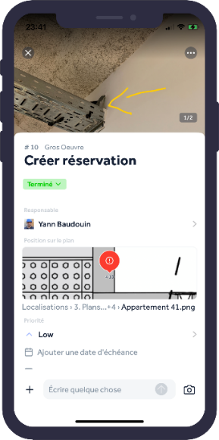
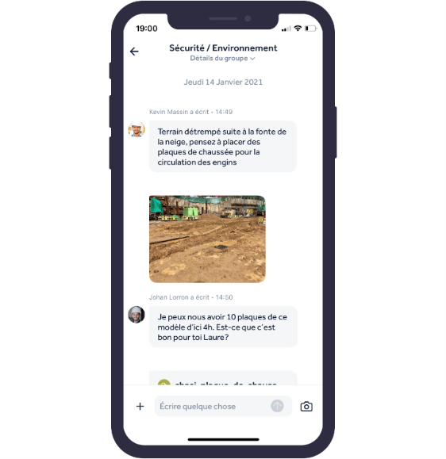
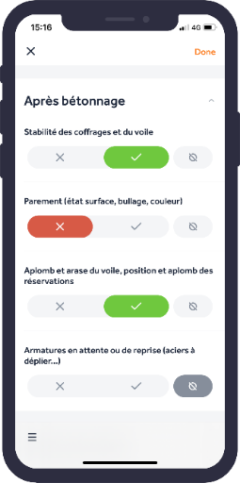
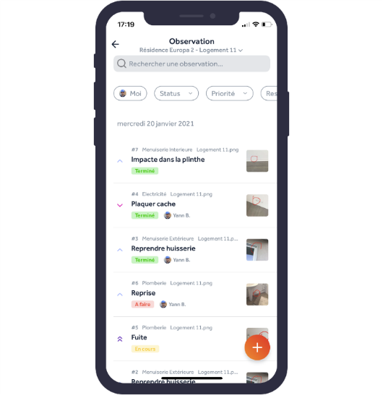
Illustration 1: Web and mobile solutions allowing to collaboratively follow the progress of reparation or construction sites are emerging on the market
Client-facing
Operations
Tablets or mobile apps
Example of similar initiative
Site monitoring platform – Finalcad (1/2)
Main clients
(over 20,000 projects supported in 35 countries and $63m raised)
1
Collaboration interface to:
Communicate with all actors (information sharing)
Contextualize the exchanges with the concerned plans
Follow the news feed of all the sites, their progress
Optimize visits and go to priority projects
Structure exchanges in working groups
3
Safety, Health and Hygiene interface to:
Identify existing risks and document situations that could endanger teams
Share risk situations with all concerned, accelerating and centralizing information sharing
Adapt audit and security controls to the new risks identified, facilitating the securing of future projects
2
Quality control interface to:
Perform checks and audits and verify compliant work.
Record defects: take pictures of defects and assign them to the concerned teams with delay, helping the project supervision
Harmonization of the site with shared defect and control libraries
4
Progress monitoring interface to:
Organize all assignments to be completed by allocating specific tasks to the relevant teams
Monitor the progress of the teams' work thanks to the observation statuses
Anticipate future projects by managing human and financial resources of current projects
Sources: eleven research and analysis

Slide 26
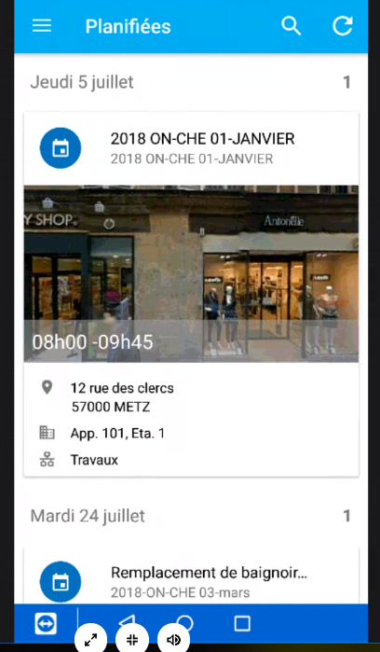
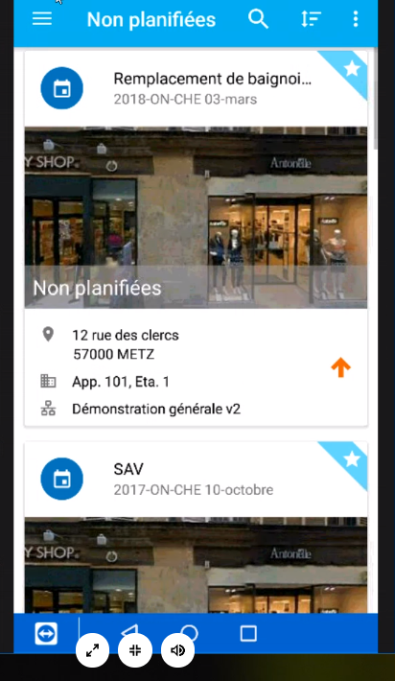
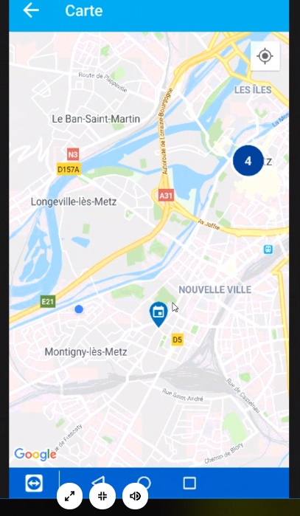
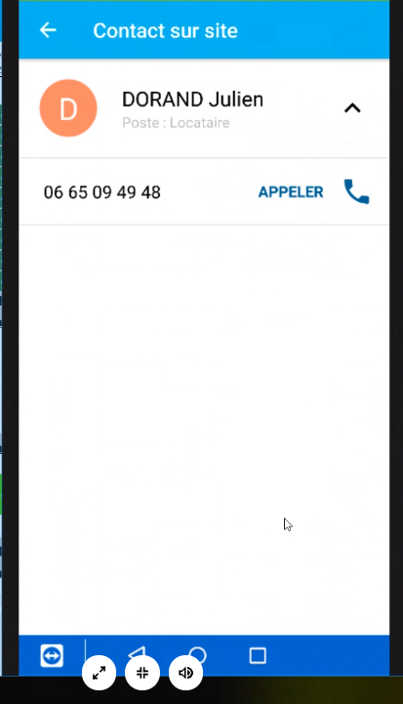
Illustration 2: Mobile solutions are also emerging to assist craftsmen during their interventions (1/2)
Tablets or mobile apps
Operations
Example of similar initiative
Mobile solution to assist the technician during his intervention - 90Tech (1/2)
1
Visualization of planned or unplanned intervention sheets with
GoogleMaps photo of the street
Accessibility information
Description of the mission
Customer contact
Attachments uploaded beforehand if needed (e.g. building plan)
2
Visualization of the day's interventions on GoogleMaps and geolocation (if activated on the GoogleMaps application)
3
Contact of the building's referent and possibility to call him from the application
Arrow indicating a priority
Sources: eleven research and analysis

Slide 27
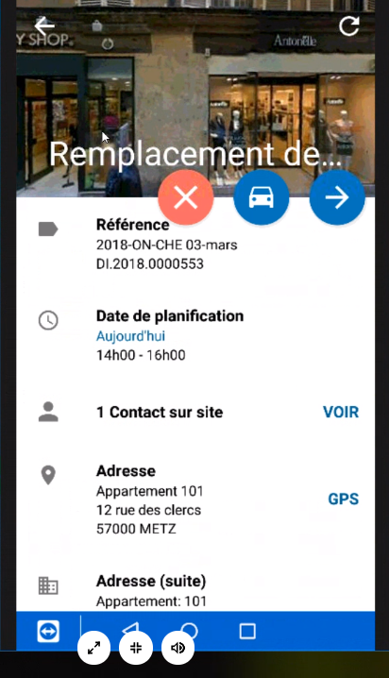
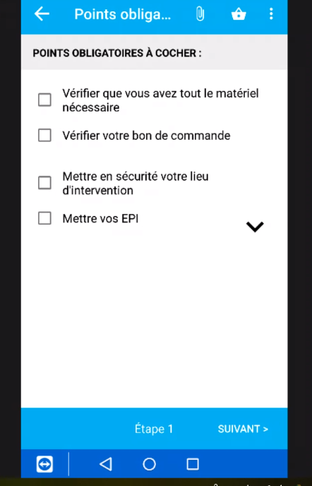
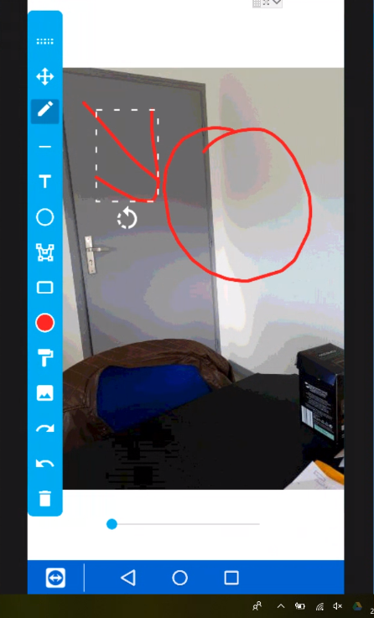
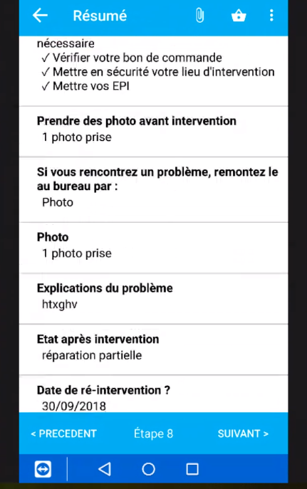
Illustration 2: Mobile solutions are also emerging to assist craftsmen during their interventions (2/2)
Tablets or mobile apps
Operations
Example of similar initiative
Mobile solution to assist the technician during his intervention - 90Tech (1/2)
4
Reporting of failed interventions (comments required)
Possibility to start a route in GoogleMaps or Waze
“Start the intervention”
5
Customization of the intervention processes by step
Need to validate all processes to move to the next step
6
Possibility to take photos of the intervention
Geolocation option of the photo
7
Summary of the intervention with comments and photos to be validated by the technician
Validation that will generate the PDF intervention report
Sources: eleven research and analysis

Slide 28



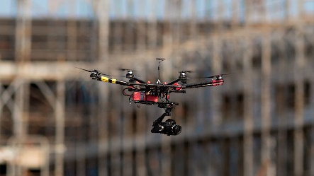
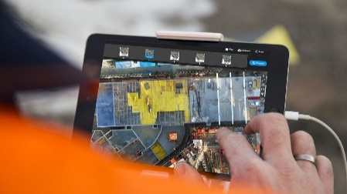
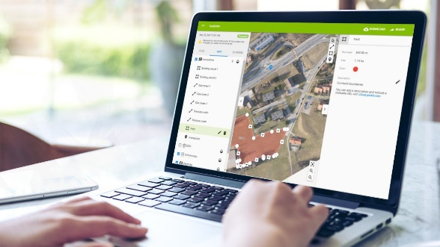
Illustration 3: Solutions on the market now use drone images to model and analyze construction sites
Computer vision
Operations
Example of similar initiative
2D/3D drone image analysis and modeling software – Pix4D
Main clients
(over 55,000 active users and 570,000km² modeled)
On-site image capture and digitization
Analysis and inspection of 2D/3D drawings
Restitution and shared visuals
Capture of RGB, thermal, or multispectral images by drones
Transformation of collected data into digital cartography and 3D models via Pix4Dmapper mobile platform and integration with BIM
Simplified inspection of the construction site via Pix4D's range of precise analysis tools (distance, area, volume calculations...)
Comparison of 2D/3D visuals of the construction site with the planned plan to identify and correct errors at low cost
Create and share 3D models via Pix4DCloud with all stakeholders
Flexible integration of images from various sources, including a platform for analysis of measured data
Remote controlled drones collecting photos/videos of site
Software available on tablet to assist operators
Web platform for model viewing, project tracking and sharing
Impact
Faster, safer and more efficient inspection of construction sites through the use of aerial images
Very precise monitoring of construction sites thanks to the high precision data collected and modeled
Sources: eleven research and analysis

Slide 29

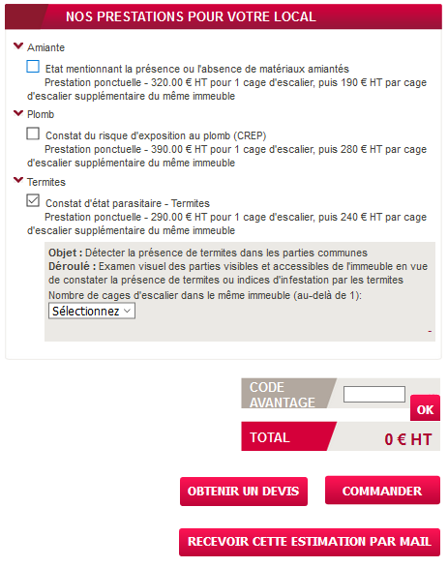
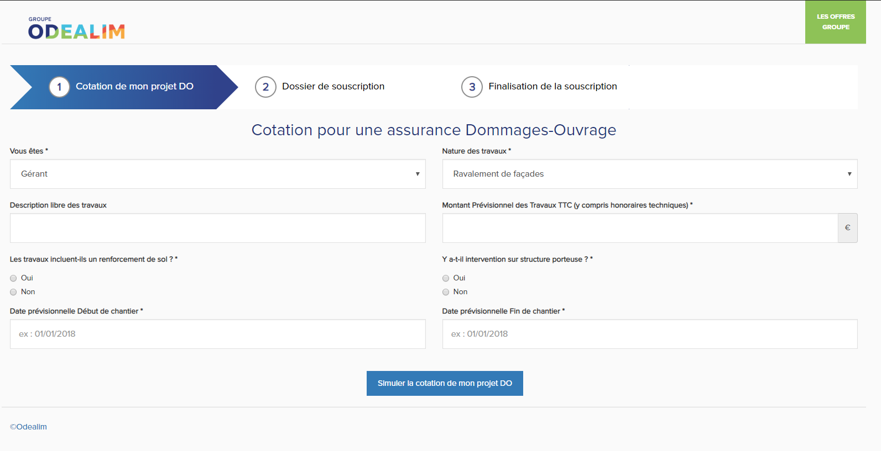
Illustration 4: Some market players are developing features allowing customers to easily recontract, and propose complementary offers to foster cross-sell opportunities
Client-facing
Contract management
Example of similar initiative
Cross-sell and B2B acquisition: automated online pricing for simple offers
Online subscription module for condominium insurance contracts with prior pricing (for trustees)
Online pricing for diagnostic services
Sources: eleven research and analysis

Slide 30
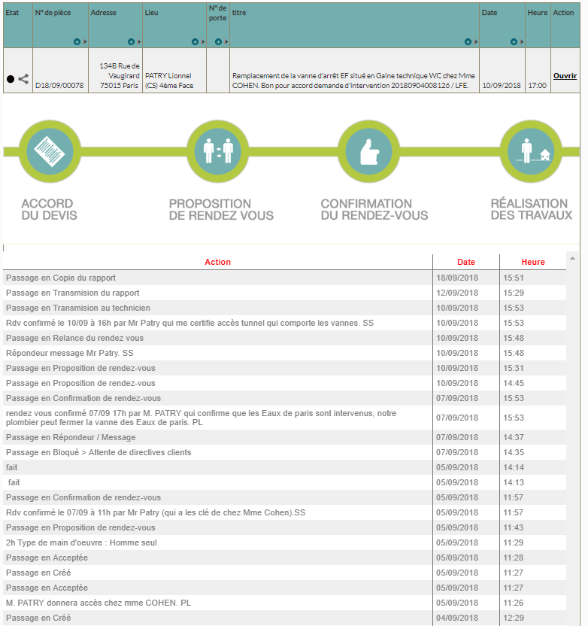
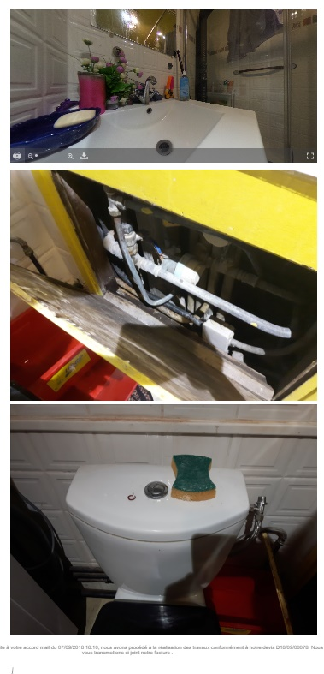
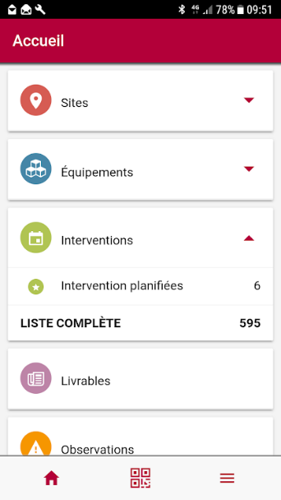
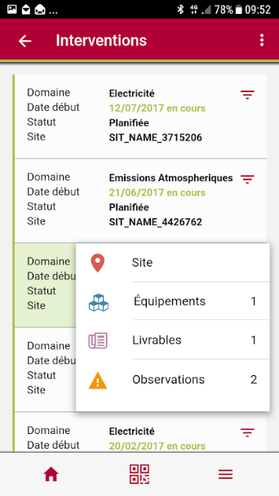
Illustration 5: Some players develop comprehensive client portal to overcome lack of clarity and accessibility of information by the client on past, current and future interventions
Client-facing
Client portal
Example of similar initiative
Client portal - Berthelot
Client Portal – Bureau Veritas
Client portal accessible on computer:
Summary of interventions by building
Macro-status of the intervention: estimate, proposal of appointment, confirmation of the appointment, realization of work
Time-stamped details of each intervention (before, during and after the intervention)
Intervention reports
Tracking of interventions and downloading of intervention reports
Intervention photos
Sources: eleven research and analysis

Slide 31














Illustration 6: Acolad, a B2B platform connecting corporate clients with a pool of freelance translators, has built a fine-tuned delivery workflow made of three main steps: sales process, project order, and project delivery, supported by a number of technological tools
Workflow structuration
Workflow
Example of similar initiative
Client acquisition
Macro-view of a B2B project management workflow in the translation industry
Sales process
Project order
Project delivery
1
2
3
Hunting
Farming
Client
request
Quote generation
Order
validation
Vendor
order
Translation delivery
Quality
control
Delivery
Lead generation
Client acquisition
RFP process for large accounts
Increase of sales on existing accounts
Reception of detailed client request
Quote sending
Quote validation by client
Vendor sourcing
Creation of project package
Order sending
Translation by vendor
Facultative review
Delivery to client
Invoicing
Key tasks
Quality control by internal translator teams
Task creation
File analysis
Quote generation
Key players
Sales
KAM
KAM
KAM
KAM
KAM
KAM
KAM
KAM
Client
Client
Vendor
Vendor
Internal translator
Email / phone
Tools
LinkedIn
ERP (separated ERPs per entities with little functionalities)
Website (SEO/SEA),
CRM & Portal (Textmaster)
Trados studio
KAM = Key account manager
Sources: eleven research and analysis

Slide 32
Executive summary
Repository of relevant use-cases for Hestia
Outside-in assessment of digital projects for Hestia
Barriers to entry assessment
1
Outside-in assessment of internal digital projects
2
AGENDA
Risk/opportunity analysis of platform business models
3
Appendix
4

Slide 33
Use cases differ on the value or expectation from stakeholders, the technological complexity to implement them and finally their market maturity
Category
Identified use-cases for a company such as Hestia
Value Expectation
Complexity
Market maturity
Comments
Client-facing
1
Declaration of the claim and assistance in case of need
Regarding end-clients’ expectations, REN players are expected to offer an online platform to allow the insured person to follow its file easily
New cross-sell opportunities do not appear to be crucial at the moment, according to both the value and the market maturity
2
Seamless reporting advancement and follow-up through online portal
3
Enhancement of selfcare journey for clients’ issues
New cross-sell opportunities with existing clients
4
Home design services
Pro-active maintenance tools
Operations / on-the-field
5
Workers sourcing and validation for REN providers’ network
Digitalizing operations presents a significant potential for added value for REN players and workers on the field, offering a better quality of intervention to end-clients
6
Advanced evaluation of the claim
7
Optimization of claim analysis process, draft of quotation and price setting
8
Optimization of resource planning
9
Monitoring & tools during intervention
10
Operation quality control (repair evaluation)
Workflow
Management
11
Claim reporting and first draft of the quotation
Workflow management appears to be key both in terms of value and expectation. Hestia-like REN players are digitalizing their workflow management to increase their efficiency and offer new services to their customers, such as electronic signature or close follow-up of the claim file
12
Easy and quick validation step and follow-up by insurance company
13
Security and authentication (electronic signature for all stakeholders,…)
14
Reporting advancement and final documents received and stored with GED¹
15
Finalization and clients’ feedback on the service quality
Sources: eleven research and analysis, expert calls
1. Gestion électronique des documents
Deployed
Partially deployed
Internal solutions

Slide 34
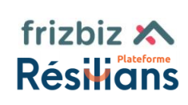


Use cases differ on the value or expectation from stakeholders, the technological complexity to implement them and finally their market maturity
Category
Identified use-cases for a company such as Hestia
Hestia answer
Use cases-coverage
Deployment status
eleven assessment
Client-facing
1
Declaration of the claim and assistance in case of need
Hestia seems to have grasp the challenges to answer clients’ expectations, but the specifications remain somehow blurry and need to be specified to fully cover the use-case
Hestia’s partnership for cross-sell opportunities remain preliminary for the moment but tools seem to be adapted
2
Seamless reporting advancement and follow-up through online portal
3
Enhancement of selfcare journey for clients’ issues
To be defined
New cross-sell opportunities with existing clients
4
Home design services
Not disclosed
Pro-active maintenance tools
Operations / on-the-field
5
Workers sourcing and validation for REN providers’ network
Internal process
Hestia’s answers for operations use cases seem limited and localized and may not fully cover each use cases
Future project Prodapps may be the answer but is not expected to be ready until the end of 2022
6
Advanced evaluation of the claim
7
Optimization of claim analysis process, draft of quotation and price setting
8
Optimization of resource planning
9
Monitoring & tools during intervention
To be defined
10
Operation quality control (repair evaluation)
Prodapps
Not addressed
Workflow
Management
11
Claim reporting and first draft of the quotation
Hestia’s use of Sinapps remains preliminary with only an EDI, waiting for the API
Docuware responds partially to files storage needs, but it lacks AI to automatized the sorting process including for e-mails
CEREN narrows to one entry point but does not address the distribution of the workflow
12
Easy and quick validation step and follow-up by insurance company
13
Security and authentication (electronic signature for all stakeholders,…)
14
Reporting advancement and final documents received and stored with GED¹
15
Finalization and clients’ feedback on the service quality
CEREN
Sources: eleven research and analysis, expert calls
1. Gestion électronique des documents
Deployed
Partially deployed
Internal solutions

Slide 35


Eleven proposes to combine the use case importance and the quality of the solution chosen by Hestia to evaluate digital projects impact for each stakeholders
Methodology to estimate tools impact for each stakeholders
Example
USE CASE
Measure the importance for each stakeholders combining clients’ expectations and relevance for Hestia
Addressed use-case & relevance
All workflow management use cases concerned
X
X
HESTIA’S TOOL RESPONSE
Measure how designated tool covers the use case and its quality for concerned parties
Hestia’s response
=
=
RATIONALE IMPACT FOR EACH STAKEHOLDERS
Combines the services offered by the tool to how important stakeholders think it is to determine the impact for each stakeholders
Rationale / impact
Contrac-tors
Enhance reparation transparency
Internal
Facilitate costing, profitability calculation, intervention management, schedule monitoring by site…
Ease interfacing with other operational tools
End-clients
Decrease processing time
Sources: eleven research and analysis

Slide 36






Use case category #1: Client Facing (both insurers and insured)
Client-facing
Addressed use-case & relevance
All Client Facing use cases towards end clients except cross-sell opportunities
Hestia’s response
Client online portal
Deployment status
Customer portal development underway with delivery scheduled for June 21
Currently under discussion
Rationale / impact
Contrac-tors
Simplification of the management of "small files" with a 100% digital path on Frizbiz
Internal
Centralization of workflow simplifying file management
Development of an extensive talent pool and digitalization of all follow-up
End-clients
Simplification of the follow-up of the file and the steps taken by the insured (100% online)
Acceleration and transparency of care with simplified procedures
Technical complexity and feasibility
Addressed in part 4
Prerequisites: implementation of agile development methods and tools, interfacing skills
Market maturity
Must-have for Hestia, all actors already using it (e.g. Covéa)
Addressed in Part 4
Key Take-aways
Platform model is still under study and business application not yet fully defined (addressed in part 4)
Online client portals are market standards, with a special focus on transparency and ease of use for the claimant
Deployed
Partially deployed
Sources: eleven research and analysis, Hestia’s VDD, Hestia’s IM

Slide 37
Use case category #1: Client Facing (both insurers and insured)
Client-facing
Addressed use-case & relevance
New cross-sell opportunities with existing clients
Hestia’s response
(Custom fit-out solution)
(Interior design projects in 3D, with preview)
Deployment status
Partnerships under discussion for both companies
Rationale / impact
Contrac-tors
Increase preference through service (marketing argument to offer additional services) with continuous support from claim declaration to post-renovation refurbishment
Internal
Increase preference through service
Enhance visibility as a one-stop-shop company to insurers
Develop additional income, complementary to core business
End-clients
Simplify the whole process with a single point of contact, payment, etc.
Enhance quality guarantees with a trusted third party
Technical complexity and feasibility
None: those partnerships do not seem to represent any complexity of implementation. Nonetheless, the nature of the partnership is still to be determined (additional income through commission?)
Market maturity
Early adopters: Not very mature in the post-claim and insurance industries (for the moment, not a service offered by competitors or insurers)
Such offers are more intended for a B2C use, disconnected from claim and damage
Key Take-aways
Hestia wants to expand its commercial horizon by cross selling design solutions to its clients, with the potential to create significant income for them even if the market has not yet taken that turn
Insurers are more interested in the following complementary services: outside leaks, accessibility (reduced mobility…), energy renovation…
Sources: eleven research and analysis, Hestia’s VDD, Hestia’s IM

Slide 38


Use case category #2: Operations
Operations
Addressed use-case & relevance
Advanced evaluation of the claim
Hestia’s response
Drone (Visit before renovation work)
(remote costing)
Deployment status
Tool in deployment, already in place at the La Roche-sur-Yon agency
Test version deployed since May 2020
Rationale / impact
Contrac-tors
Possibility to address all claims without inaccessibility issues
Increased customer satisfaction, especially during a health crisis
Internal
Allow access to dangerous, difficult or forbidden areas
Ease interfacing with other operational tools
Significant productivity gains, cost and carbon footprint reductions
End-clients
Flexibility, time savings with facility to make appointment and involvement in the resolution of the claim
Technical complexity and feasibility
Low complexity of usage with a quick training for employees to grasp how to use drones in situations
If the drone is used to film a disaster, there’s regulations and the pilot needs to be certified
Low complexity of technology with simple video platform adapted to simple claim (1 or 2 professions)
Training of works managers and integration in the global process may require another tech development
For only simple claims
High costs of deployment with investments required to purchase drones
Market maturity
Most insurance companies (e.g. Allianz) offer claim expertise by drone
Must-have for Hestia, all actors already using it (e.g. MAAF, GMF)
Key Take-aways
Hestia is responding to a must-have in the insurance market with the remote costing and analysis, and could try to develop the use of drones even if the uses is limited
Deployed
Partially deployed
Sources: eleven research and analysis, Hestia’s VDD, Hestia’s IM

Slide 39


Use case category #2: Operations
Operations
Addressed use-case & relevance
Claim analysis and draft of quotation with price optimization
Hestia’s response
(reporting mobile-app)
(on-site mobile app for quotation)
Deployment status
Historical tool for VA and 3iD, already deployed for Nüwa in 2021
Already deployed for the three companies
Rationale / impact
Contrac-tors
Reduce process time
Reduce fraud risk or misstatement of damages
Reduce process time
Improve responsiveness thanks to automatic quotation transmission
Internal
Reduce wasted time writing reports post-intervention
Adapt to new requirements
Avoid hours of entering quotations and back-and-forth to the customer
Increase in-the-field reactivity
Decrease delay in invoicing, payment, with fewer reminders
End-clients
Decrease processing time
Improve global satisfaction through immediate quotations
Technical complexity and feasibility
Kizeo “Web Services” provides queries for interfacing with existing business solutions (mass creation/modification of users and groups, new customer information…)
Need for an API to connect to an ERP or CRM
Possibility to drag and drop products and works from company’s database or supplier catalogs
No further information on interfacing possibilities
Market maturity
Early adopter: not yet mature on the market in terms of use, but in line with the growing need for real-time and structured information
Fragmented market
Average, fragmented market with many localized players and few references
Key Take-aways
Hestia has developed tools for its operations teams, moving ahead of the market, with the potential to have a moderate impact on its performance
Deployed
Partially deployed
Sources: eleven research and analysis, Hestia’s VDD, Hestia’s IM
Notes:
https://www.kizeo-forms.com/fr/fonctionnalites-webservice/

Slide 40


Use case category #3: Workflow management
Workflow
Addressed use-case & relevance
All workflow management use cases concerned
Claim reporting (entry)
GED storage
Hestia’s response
Single point of entry &
CEREN Portal
Deployment status
Entirely deployed on the 3 companies by end of 2021, with an API to connect to Sinapps
Launched in the beginning of 2021
Deployment VA and 3iD in Jan 21 before Nüwa in April
Rationale / impact
Contrac-tors
Enhance reparation transparency
Simplify the process of work allocation
Internal
Facilitate costing, profitability calculation, intervention management, schedule monitoring by site…
Ease interfacing with other operational tools
Decrease of time loss related to administrative processing ; develop preference through service
Productivity gains and reduced risk of error by eliminating the manual data entry step
End-clients
Decrease processing time
Decrease processing time
Technical complexity and feasibility
Low complexity of full deployment by end of 2021: Deployment of v1 already carried out on 3 companies with key features
Medium complexity of API development (code capabilities, API governance, possible externalization…)
None (already deployed)
Need to ensure that all contact points are redirected to the portal as the single point of entry
Teams already familiar with GEP (previously using Acropolis and Therefore)
Market maturity
All insurance companies have developed ERP or are using external ones
Hestia is anticipating a surge in repair in kind
Market maturity at full potential
Key Take-aways
Hestia is following the market pace regarding the digitalization of its workflow management and is even anticipating a future surge in repair in kind with a dedicated platform (CEREN)
Deployed
Partially deployed
Internal solutions
Sources: eleven research and analysis, Hestia’s VDD, Hestia’s IM
Notes:
ERP: Une plateforme de coopération, une nécessité pour le secteur des assurances ? | Realdolmen

Slide 41
Digital maturity seems to be a key factor in the growth of market players and in the consolidation of competitive position, especially when they reach a critical size through peers’ acquisitions
Hestia and peers’ positioning according to their digital maturity
Comments
Fully digitalized
Digital appears to be a prerogative of the best players for it helps major companies strengthen their position in the competitive landscape and grow significantly allowing them to make differentiating investments
2
1
1
Best-in-class players have started their digitalization several years ago, with the objective of offering a 100% digitalized and omnichannel experience to insurers and insured customers
Digital maturity
1
2
3
4
3
2
Digital early adopters have relied on digitalization in the first place, rather than acquiring other companies to support their growth
Hestia
4
3
Increasingly digitalizing players are catching up with market standards, in terms of process and industrialization, while innovating on some distinct projects
Impractical area
Few digital initiatives
5
4
Traditional players with little digitalization have remained in their historical business without investing in technologies, partnerships or building customer-first solutions
Localized or minority players
Competitors’ size (including international presence)
International players or market leaders
Key Take-aways
Hestia faces two challenges in the coming years: first to finalize its digital transformation in order to integrate all companies under the group and then to digitalize its operational tools to compete against international players and market leaders
More details in core document
Sources: eleven research and analysis, expert calls

Slide 42
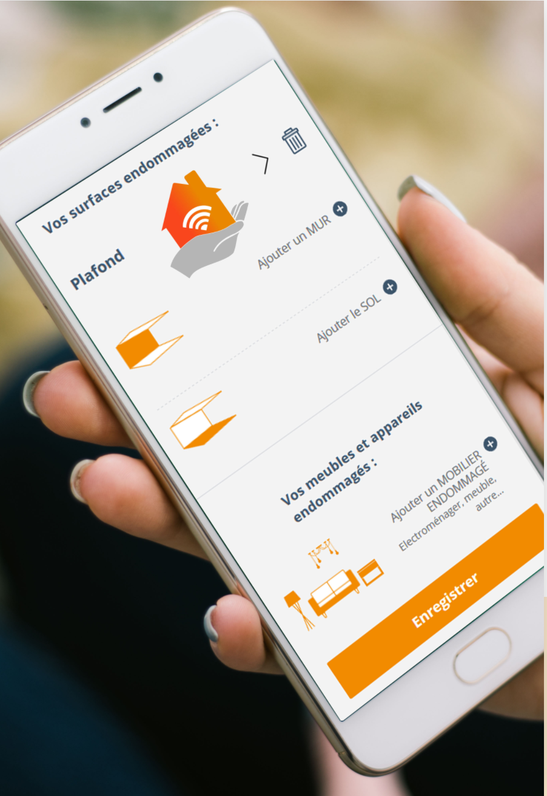




Peers / Competitors – Stelliant Stelliant has chosen to grow thanks to acquisitions such as GEOP Assistance or AAD Phenix but also to reorganize itself as a group and to develop common technological tools
1
Stelliant’s evolution
Digital initiatives
Fully digitalized
Digiclaims is an integrated app solution that allows the insured or the insurance manager to qualify, obtain an evaluation of a claim and activate the appropriate solution in a few clicks
Advantages:
Easy: simple and quick use
Fluid: simplification of client relation
Flexibility: anytime, anywhere
Innovating: 1st web app to offer this service
CA 2019 - €250m
2019 – 5 activities
Digital maturity
4
3
2017 – group notion
2
1
Impractical area
CA 2014 - €100m
Visiotex, developed by TEXA Expertises offers people to carry out the expertise through visio from their smartphone
Advantages for the insured person:
All-in-one in the first screen
Involved in the process by transmitting information related to the claim
Advantages for insurance company:
Optimizing over-the-counter with easier negotiations and no expert’s movement
Modernizing insurance/insured relation
Reality of the claim confirmed
Securing average costs
Few digital initiatives
2009 – 2 activities
Minority players
Competitors’ size (including international presence)
Market leaders
1
2015 - Stelliant (ex Texa) buys GEOP Assistance
3
2018 - Stelliant buys AAD Phenix to speed up its growth
2017 - Stelliant launches Digiclaims (100% digital tool) with its Lab and its subsidiary Texa Expertises
2019 - Stelliant buys GM Consultant to reinforce its subsidiary TGS specialized in consulting and expertise
2
4
Key Take-aways
Hestia seems to be following the same kind of trajectory as Stelliant, with a strong acquisition strategy, while industrializing internally for greater group consistency
Sources: eleven research and analysis, expert calls
Notes:
Digiclaims - Geop Assistance (geop-assistance.com)
L'innovation - Texa Expertises
SS_Stelliant_FR_02032020.pdf (talentia-s
Qui sommes-nous ? - AAD Phenix (aad-phenix.com)oftware.com)

Slide 43

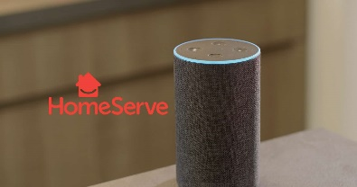
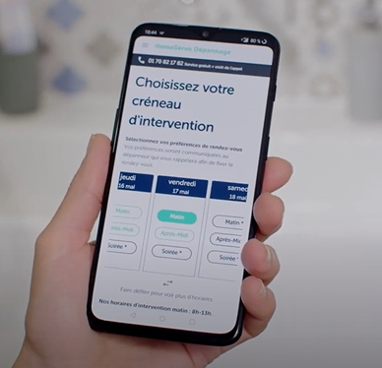
Peers / Competitors – HomeServe HomeServe has made the shift to being a home service provider, close to the customer (IoT, voice assistants…) while acquiring peers to develop its network of craftsmen
2
Homeserve’s evolution
Expansion and digital initiatives
Fully digitalized
From 2001 to 2012 – Multiple geographical expansion with joint ventures modalities
1
2014 – Launch of assistance offer for connected objects (partnership with Tado)
2014 – Transition to Oracle E-Business (ERP)
2016 – Launch of custom online emergency services through acquisitions
2016 – Launch of Leakbot (leak connected detector)
2016 – Investment in speech recognition technology
2017 – Launch of Tom, chatbot on Messenger for plumbing issues
Digital maturity
3
2
2
Impractical area
Few digital initiatives
1
2019 – Implementation of a seamless omnichannel platform for customers and partners
Switch to single Salesforce tool to develop a 360° vision of customers
2019-2020 – Development of vocal assistants (Google & Alexa)
Emergency assistance with quick advice and an alert to the call center, which will then contact the customer
Intelligent voice application for home tips and tutorial (DIY offer)
2020 – Acquisition of Carglass Maison and of a specialist in energy renovation
Minority players
Competitors’ size (including international presence)
Market leaders
3
Vocal assistant
Selfcare application
Key Take-aways
Homeserve has transitioned towards being a home service provider, and therefore need to enhance its visibility to customers and transform the company’s contact points with them
Sources: eleven research and analysis, expert calls
Notes:
https://www.larevuedudigital.com/lassistant-vocal-nouveau-canal-client-lere-des-pionniers-avec-la-societe-dassistance-homeserve/ Pour l’heure, les dispositifs du type des enceintes connectées sont encore peu répandus en France. Une étude menée par HomeServe avec le cabinet CSA montre au début de 2020 que seulement 18% des Français sont équipés de ce type de dispositif. Ce chiffre n’inclut pas les usages des assistants vocaux de Google et d’Amazon qui sont aussi accessibles via le smartphone.
https://www.capgemini.com/2019/06/making-transformation-human-for-homeserve/
https://www.webmecanik.com/interview-arnaud-leroux-automationday/

Slide 44

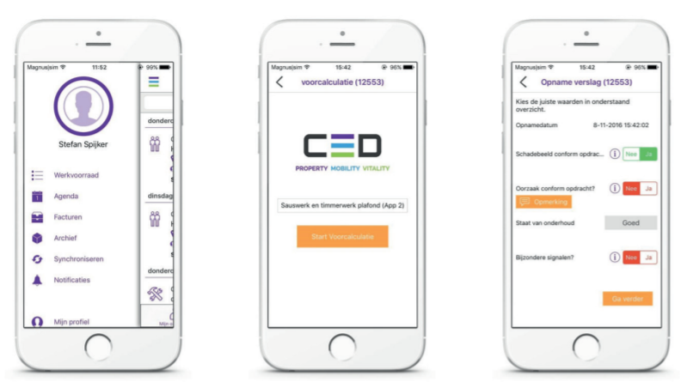
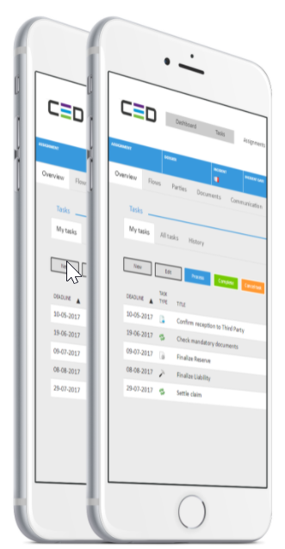
Peers / Competitors – CED CED has developed a solid technological base on which modules for the insurer and the insured can be plugged, and has leveraged AI capabilities to automate most of claims’ management
3
CED Connect Claims Platform illustration
Comments
Contractors
CED Connect is the in-house InsurTech operation of CED, where >60% of claims are handled on a fully automated basis
AI enables to calculate claim amounts automatically based solely on photos, and enable better fraud detection
CED leverages BDEO technology, that enables to:
Connect to geo-localized video call initiated by a simple text message, without having to install any apps on your cell phone
Obtain documentary evidence thanks to remote photos and video capture system
AI engine to analyze documentary evidence to prevent fraud and reduce costs
Next steps in their digitalization: proposing 100% digitalized paths (making appointments online directly with experts on their smartphones, having access to experts’ agendas) with the following support:
50 developers in Tunis to address digitalization and innovation stakes
Their investment fund, to partner with insurtech companies
Hub (connect to other client systems)
Sources (connection to external data sources for fraud checks, risk mgt…)
Cube (dashboard & real-time insight)
CED Connect Claims Platform
Evaluation of the content of the claim (circumstances, fraud detection, coverage control, value of goods estimation…)
Status of reparations
Communication module
Web portal and app (self service to report and monitor claims)
Legend
Core
End-clients
Module
Key Take-aways
It would be relevant for Hestia to build a flexible system architecture with modules for both the insurer and the insured client for enhanced consistency
Some players like CED increasingly invest in AI, which enhances their operational efficiency and is potentially creating a new barrier to entry
Sources: eleven research and analysis, expert calls

Slide 45
Peers / Competitors – Multiasistencia Multiasistencia has chosen to focus on digital early on and to provide a set of self-managing and personalized solutions to the customer, by automating its workflow
4
Multiasistencia digital chronology
Digital tool –Voicebot
Focus on digital solution for operational efficiency
New digital channel that allows end-users to communicate and interact during the management of their claim
Macarena, an AI voicebot for a fully automated home claims FNOL and steering
Introduced in February 2019, Macarena is the first voicebot capable of handling a claim process all the way without any human assistance other than the repair itself
2014
2015
2016
2017
2019
Replaces an agent from the call center, available 24/7
Renewal of SysteMA (technology platform to improve performances, power, adaptability and safety of systems)
Launch of Digital Solutions to improve the claim management process
Identifies more than 1,300 combination of cause and damages
Schedules an appointment for claim reparation
Verifies craftsmen’s arrival on site
Handles the closing of the claim file directly
Between January and August 2020, the voice bot answered 500,000 calls and could resolve 30% of claims without human assistance.
More generally, being connected to sMArt (digital solutions) it automizes 86% of files registration
“The development of a digital platform was a strategic issue and a potential business opportunity, so it was necessary to develop it ourselves. Today it is even sold to some of its competitors.”
– Former Director of Board at Multiasistencia
Key Take-aways
Multiasistencia’s solutions allow to customize the offer, apply decision-making algorithms that weigh the value of the client, automate decisions… For the insured, it allows to control the process end-to-end (getting information, contracting, giving notice of the claim, managing visits online)
… all reinforcing Hestia’s will to be customer centric (transparency, communication…) and operationally efficient
Sources: eleven research and analysis, expert calls

Slide 46


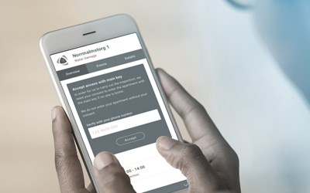
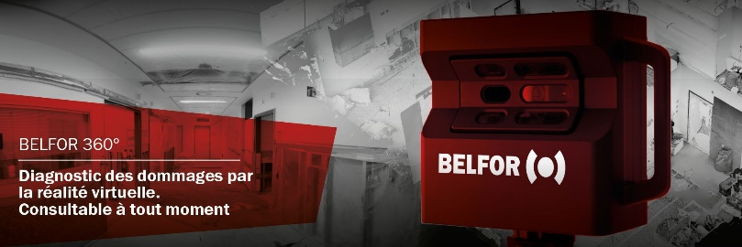
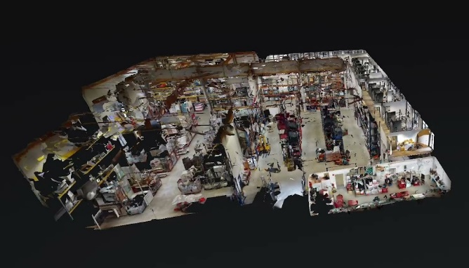
Peers / Competitors – Other peers’ initiatives (Polygon Group, Belfor) Belfor optimizes claims management with virtual reality claims processing, while Polygon has developed a service ease communication between its clients and the end-customers
5
Polygon’s digital initiatives
Belfor’s digital initiatives
Belfor 360 : outil innoation, traitement de sinistres par la réalité virtuelle
Optimise, simplifie et raccourcit la gestion des sinistres
3D virtual diagnosis
Spark App
Development of a digital solution for property managers and their residents: app « SPARK » (internally) to provide information, documents as well as improve communication between stakeholders
Investment (minority share) in Caption Data Limited, a remote monitoring solution based on IoT for use in residential and commercial property for further partnerships
Virtual diagnosis of damage through a high-definition 3D camera:
Recording of the location of the damage after the incident and damage diagnosis as a virtual tour (free navigation)
Zoom, annotation and dimensioning function, each element can be freely measured afterwards
Creation of high precision ground plans
Automatic creation of photos, OBJ files, videos, or other data for further processing
Solid basis for damage assessment without manual intervention
Key Take-aways
Other peers’ positioning confirms the relevance for Hestia of greater precision in the evaluation of claims, as well as on providing solutions with more communication and transparency for both insurers and customers, or the will to intervene in the pro-active monitoring and maintenance market
Sources: eleven research and analysis, expert calls

Slide 47
Executive summary
Repository of relevant use-cases for Hestia
Outside-in assessment of digital projects for Hestia
Barriers to entry assessment
1
Outside-in assessment of internal digital projects
2
AGENDA
Risk/opportunity analysis of platform business models
3
Appendix
4

Slide 48
Hestia wishes to overcome the first barriers to entry with its digital transformation while anticipating the incoming one regarding operational tools
Hestia positioning according to its digital maturity and barriers to entry
Comments
Digital barrier to integrate the complex insurance ecosystem
Building an efficient platform for both insurance company and end clients takes about 3-4 years
Digitalizing its workflow management is a must-have in this market for it optimizes the process and delivers a higher quality of service to all stakeholders
Digitalizing its workflow management appears as a necessity to integrate various companies
Fully digitalized
International players or market leaders
2
1
Barriers to entry #2
Digital maturity
1
Hestia
Barriers to entry #1
Digital as a differentiation tool
Operations advanced tools monitoring operations in the field and workforce management
Competitors are developing IA tools and deep learning algorithms to optimize various steps in the global process such as drafting quotation with price optimization
Digitalizing tools used by workers in the field could be the next significant evolution and could create a new barrier to entry in the coming years
Localized or minority players
Impractical area
Few digital initiatives
2
Competitors’ size (including international presence)
Key Take-aways
Hestia needs to focus its efforts on overcoming the first barrier before expanding into priority 2 use cases and integration of other tools or partnerships, given an already ambitious digital roadmap
Indeed, digitalizing all the process appears as a growing necessity as a company grows and wishes to create group synergies and consistency
Sources: eleven research and analysis, expert calls

Slide 49
Future evolutions could help Hestia industrialize frequent expertise thanks to selfcare and automated response before personalize it at the end of the process
Identified use-cases for a company such as Hestia
Eleven proposition
Potential impact for Hestia
Complexity
Declaration of the claim and assistance in case of need
REN providers should develop multichannel solutions for first notification of damage (website, WhatsApp, mobile app, SMS…)
1
Enhancement of selfcare journey for clients’ issues
Platform should be designed so that customers through their own UI can do their own intake
3
New cross-sell opportunities with existing clients
REN providers could provide complementary services such as repair of outdoor leaks, energy retrofit or on-demand work platform
4
Advanced evaluation of the claim (first-time-right intake)
Hestia could develop image recognition tools allowing to evaluate the claim directly through video, even price it or propose a scenario
5
Optimization of claim analysis process, draft of quotation and price setting
Hestia should develop AI algorithms automatizing price evaluation through automatic claim capture and historical claim data base allowing to narrow analysis and induce high-added value files for insurers
6
7
Optimization of resource planning : assignment repairer fit, dynamic planning tool…
Hestia should try to personalize repair-in-kind by matching repairer to a customer based on craftsmen historical interventions and customers compatibility
Claim reporting and first draft of the quotation
Hestia should deepen what comes after the CEREN with tools helping distribute the workflow and use data to evaluate the need in resources (number of interventions in coming days)
9
Security and authentication throughout the process (electronic signature for all stakeholders,…)
Hestia could invest in blockchain technology to secure, certify images, videos, analysis or electronic signatures
11
Reporting advancement and final documents received and stored with GED
Hestia could automatize documents storage in the GED with AI powered tools to store emails, finalized documents, follow-up reports, intervention reports
12
Legend
Easy build-up
New development
Strong technological complexity
Sources: eleven research and analysis, expert calls
Sources: eleven research and analysis, Information Memorandum

Slide 50
Executive summary
On Hestia’s historical market, new IT tools have appeared to facilitate the collaboration between all stakeholders
Beyond these tools, platform business models have appeared, representing both risks and new business opportunities for Hestia
Assessment of platform risks for Hestia
On this market, different growth opportunities could be addressed by Hestia leveraging Frizbiz
1
Outside-in assessment of internal digital projects
2
AGENDA
Risk/opportunity analysis of platform business models
3
Appendix
4

Slide 51
Technical evolutions are leading to the emergence of new digital players such as on-demand renovation platforms, as well as new technical solutions to facilitate exchanges between stakeholders and workflow management
Competitive landscape on post-loss management
In-kind compensation
Over-the-counter compensation + On-estimate compensation
Beneficiaries
Demand side
Insurers
Companies (e.g. condominium syndicate)
Individuals
…
Technical solutions providers
On-demand renovation platforms
Post loss stakeholders
B2C
C2C
Software editors
Expertise companies
REN providers
Large and multi-specialty work
Spot requests and small works
Integrated model
Non-integrated model
…
Interoperable solution
…
…
…
…
…
…
…
Professionals
Supply side
Employed professionals
External professionals
Individuals
Sources: eleven research and analysis

Slide 52
Darva has developed a tool, Sinapps, that simplifies the connection to insurances and post loss stakeholders’ workflow management, which could reduce barriers to entry and facilitate the emergence of small REN providers
1. Risk #1
Competitive landscape on post-loss management
In-kind compensation
Over-the-counter compensation + On-estimate compensation
Beneficiaries
Demand side
Insurers
Companies (e.g. condominium syndicate)
Individuals
Risk #1
Risk: Sinapps, by providing to REN providers an interface with insurances and expertise companies and workflow management tools, reduces barriers to entry and favors the emergence of small REN providers
Assessment: Although it is limited as of today as Sinapps adoption remains low, this risk could increase in the mid-term as:
The Sinapps tools gives small REN providers the ability to connect with insurances and therefore increase the competition
The Sinapps workstation facilitates the workflow management for small REN providers that have not invested in sophisticated software and might enable them to compete with more advanced REN players as Hestia
…
Technical solutions providers
Digital platforms
Post loss stakeholders
B2C
C2C
Software editors
Expertise companies
REN providers
Large work
Small to medium work
Integrated model
Non-integrated model
…
Interoperable solution
…
…
…
…
…
…
…
Professionals
Supply side
Employed professionals
External professionals
Individuals
Low risk
Medium risk
Focus on the following pages
Sources: eleven research and analysis

Slide 53

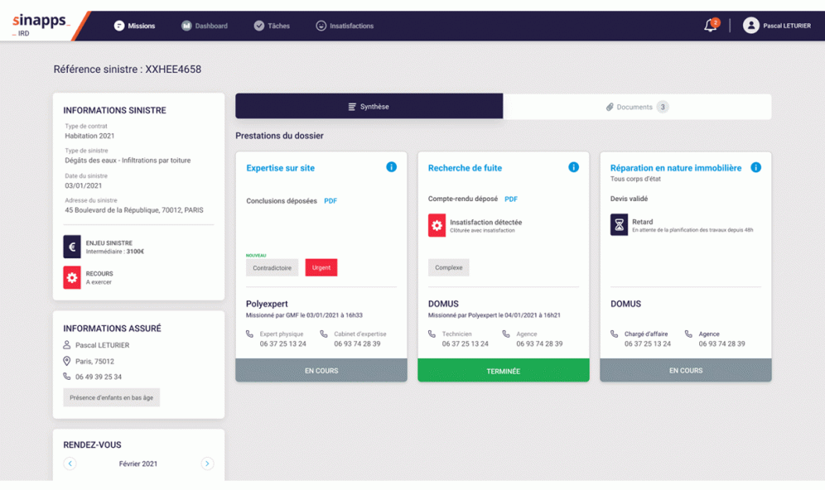
In an attempt to achieve the digital transformation of the post-loss industry, insurers have modernized the DARVA software used by service providers to create Sinapps, a shared cloud space where all stakeholders can collaborate
1. Risk #1
Comparison between former DARVA IARD and new Sinapps IRD solution
Darva IARD
Darva Sinapps IRD
Stakeholders
Insurers
Expert companies
Renovation companies
Insured person
Loss management software editors
Darva IARD
Allowing insurance companies to send orders of mission to their expertise or REN companies
Making exchanges between all parties involved more fluid
Improve the quality and productivity of business processes
Objective
Description
EDI protocol in which insurers push missions to execute towards expertise and renovation companies
One-way flow of information: insurers send information towards external partners
Insurers have the ability to customize their loss forms and select the information they want to obtain
Accessing loss information: loss pictures, insured person contact information, order of mission, etc.
Monitoring of the progress of the case: appointments, next steps, etc.
Structuring of business processes for experts and renovation companies: divide the workflow into sequenced steps
Managing compensations remotely: sending compensation proposals to insured person
Functionalities
Functionalities
Sinapps IRD’ dashboard for 360° overview
Still used but will eventually disappear to be replaced by Sinapps IRD
223,000+ orders of mission handled in 2020
KPIs (according to Darva’s website)
15 expertise companies
15 renovation companies
Sources: eleven research and analysis, Darva’s website

Slide 54
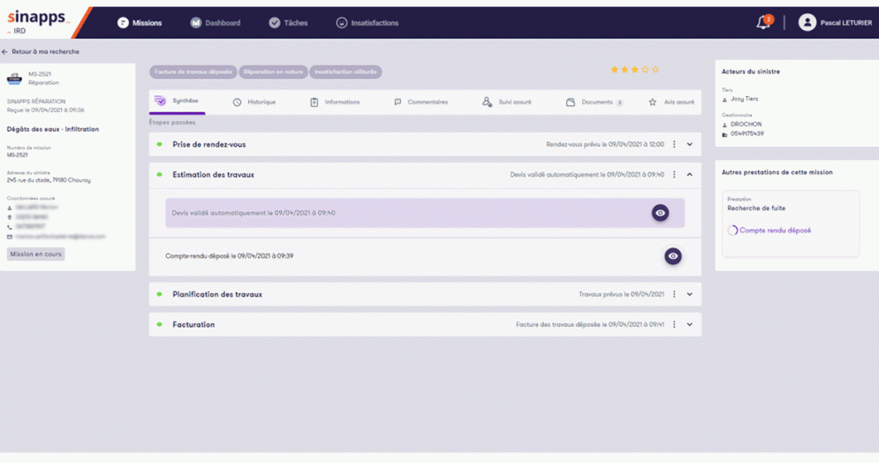
Sinapps IRD’s envisioned offer is to offer collaborative business tools to REN stakeholders, which could then facilitate the emergence of smaller REN players and thus represents a moderate risk for Hestia
1. Risk #1
Focus on Sinapps IRD’s business tools and possible impact for Hestia
Darva Sinapps IRD
Set of APIs that connect to expertise and renovation companies’ information systems and automatically transfer information toward insurers
The appearance of interconnected IT tools and dashboards such as Sinapps generates greater simplicity for insurers to collaborate with loss management providers, which might weaken the entry barriers on Hestia’s market
Offer 1: Bilateral flow of information
Offer 2: Additional set of business tools that replace each player’s (expert or renovation companies) internal solutions
Sinapps IRD’ business tools for renovation and diagnostics service providers
Sinapps becomes the main day-to-day IT tool for expertise and REN providers
“There is little chance that any major expertise or renovation company will take that path as it completely dilutes their value proposition. They would lose their ability to differentiate through their interaction with insured persons, which is key in order to remain among insurers’ top partners.”
– CEO at Sedgwick France
Reportedly no major expertise companies and little to no REN providers have agreed to use this solution
Implications for Hestia
Developing APIs to connect to Sinapps’ Offer 1 seems free of risk for Hestia as it mainly facilitates the operational process and information input between parties
However, Hestia should be cautious regarding Sinapps’ Offer 2 as using Darva’s workstations would result in weakening of Hestia’s differentiating opportunities towards end-users, making them a mere supplier for insurers
Thanks to Sinapps IRD workstation module, smaller REN providers might enter in direct contact with insurers and therefore use it as their main information system. This could indeed lead to a potential reduction of the entry barriers on Hestia’s market, providing these players have the required credentials to work with insurance companies
Sources: eleven research and analysis, expert interviews

Slide 55
The risk of Sinapps becoming a post-loss renovation platform appears highly improbable as it would require Sinapps to change its software editor activities into REN activities: unify a craftsmen network, monitor worksite and carry the execution risk
2. Risk #2
Competitive landscape on post-loss management
In-kind compensation
Over-the-counter compensation + On-estimate compensation
Beneficiaries
Demand side
Insurers
Companies (e.g. condominium syndicate)
Individuals
…
Technical solutions providers
Risk #2
Risk: Sinapps could leverage its technical solution to build a platform aggregating craftsmen and becomes a REN provider
Assessment: This risk appears highly improbable as Darva is an IT company with activities far from « in-kind » reparation. Indeed, being a REN provider requires:
To unify and lead a craftsmen network
To employ work managers that ensure the monitoring on worksite
To carry the execution risk
On-demand renovation platforms
Post loss stakeholders
B2C
C2C
Software editors
Expertise companies
REN providers
Large work
Spot requests and small works
Integrated model
Non-integrated model
…
Interoperable solution
…
…
…
…
…
…
…
Professionals
Supply side
Employed professionals
External professionals
Individuals
Low risk
Medium risk
Focus on the following pages
Sources: eleven research and analysis

Slide 56

To offer a REN platform where insurances could directly contract with craftsmen, Sinapps would have to develop skills that are far away from its current core activities
2. Risk #2
Analysis of the implications behind Sinapps
Today: Sinapps facilitates the flow of information between all parties involved in post-damage compensation
Tomorrow: greater share of direct contraction of intervention companies thanks to collaborative platform such as Sinapps?
Insurance companies
Insured person
Insurance companies
Assumptions not backed by experts
B2C platforms leveraging Sinapps’ API
Sinapps IRD
Software platform connecting stakeholders to ease administrative management of renovation project
Craftsmen network creation
Craftsmen staffing and monitoring
Client support and damage assessment
Expertise companies
Loss management software
REN players
Expertise companies
Craftsmen
“Today Sinapps is basically a pipe that dictates the in-kind reparation process for all stakeholders.”
– CEO at Sedgwick France
“I doubt that Darva would position as a REN consolidating platform. It is a completely different business, you need to have full control over the workforce to ensure the maximum level of service to insurers.”
– CEO at Sedgwick France
Implications for Hestia
Although Sinapps simplifies the direct collaboration between insurers and renovation companies, it remains an IT tool with an ambition to simplify information flux and not disintermediate experts and REN providers
Limited chance of Sinapps IRD becoming a platform that federates local renovation companies
Sources: eleven research and analysis, expert calls

Slide 57
Executive summary
On Hestia’s historical market, new IT tools have appeared to facilitate the collaboration between all stakeholders
Beyond these tools, platform business models have appeared, representing both risks and new business opportunities for Hestia
Assessment of platform risks for Hestia
On this market, different growth opportunities could be addressed by Hestia leveraging Frizbiz
1
Outside-in assessment of internal digital projects
2
AGENDA
Risk/opportunity analysis of platform business models
3
Appendix
4

Slide 58

The emergence of on-demand renovation platforms might increase « over-the-counter » and « on-estimate » compensation which would be cheaper for insurances but ultimately seems limited as most platforms are not yet profitable and suffer from craftsmen shortage
3. Risk #3
Competitive landscape on post-loss management
In-kind compensation
Over-the-counter compensation + On-estimate compensation
Beneficiaries
Demand side
Insurers
Companies (e.g. condominium syndicate)
Individuals
…
Technical solutions providers
1
On-demand renovation platforms
Risk #3
Risk: With the emergence of both B2C and C2C platform, insured persons could increase their use of « over-the-counter » and « on-estimate » compensations
Assessment: This risk still needs to be further assessed:
The overall compensation cost for insurance is lower in REN versus over-the-counter and on-estimate
Yet these platforms don’t have the capacity to handle more renovation works due to the shortage of qualified professionals
Moreover these platforms struggle to reach financial balance due to the high acquisition cost on both supply and demand sides
Post loss stakeholders
B2C
C2C
Software editors
2
3
Expertise companies
REN providers
Large and multi-specialty work
Spot requests and small works
Integrated model
Non-integrated model
…
Interoperable solution
…
…
…
…
…
…
…
Professionals
Supply side
Employed professionals
External professionals
Individuals
Low risk
Medium risk
Focus on the following pages
Sources: eleven research and analysis

Slide 59


























The on-demand renovation platform ecosystem seems to be fragmented, with only a handful of players having found a sustainable model when the rest struggles to be profitable
1
3. Risk #3
Parent company | Company | Model | Business model | Profita-bility | Creation | HQ | FTEs | Website monthly traffic (in k) | Total funding (in €m) | Revenue (in €m) | # service providers / jobbers | # interventions
 |  | B2C | Com/sub |  | 2015 | FR | 60 | 20 | 6.8 | 1-2 | 6,000 | 1,000 (mid 2020)
 |  | B2C | Subscription |  | 2014 | FR | <10 |  | 0.5 | 1-2 | 4,500 pros
 |  | B2C | By quotation/Sub |  | 1999 | FR |  |  |  |  | 25,000
 |  | B2C | By quotation/Sub |  | 2006 | FR | 220 | 250 |  | 25 | 35,000 pros | 100,000 quotations per month
 |  | B2C | Commission |  | 2017 | FR | 60 |  | 4 |  |  | 4,500 (since 2017)
 |  | B2C | Commission |  | 2013 | FR | 33 | 65 | 1.7m series A | 1 (2017)
 | Maison Saint Gobain | B2C | Commission |  | 2016 | FR |  | 100 |  |  | 1,500 pros
 |  | B2C | Subscription |  | 2007 | FR | 10 |  |  |  | 1,000 | 10,000 (total)
 |  | B2C | Commission |  | 2014 | FR | 10 |  |  |  |  | 1,400 (in 2017)
 |  | B2C | By quotation |  | 1999 | UK | 60 |  |  |  | 2,500 | 50,000 quotations per month
 |  | B2C | Commission |  | 2014 | FR | 98 |  | 2 | 100 (2022e) | 1,000 pros | 30,000 (in 2018)
 |  | B2C/C2C | Commission |  | 2012 | FR | 15 | 50 |  | 1.1 (2020) | 200,000 incl 5,500 pros
 |  | B2C/C2C | Commission |  | 2011 | FR | 35 | 20 | 9
 |  | B2C/C2C | Subscription |  | 2006 | FR | 60 | 200 |  | 5 (2017) | 20,000 pros | 300,000 (since 2006)
 |  | B2C/C2C | Commission |  | 2012 | FR | 20 |  | 1.1 |  | 14,000 | 500,000 (total)
 |  | C2C | Commission |  | 2015 | FR | 10 à 50 |  |  |  | 300 | 50,000 (total)
 |  | C2C | Commission |  | 2008 | US | 50-100 | 15 (.fr) | 37 |  | 60,000
 |  | C2C | Commission |  | 2014 | FR | 50 |  | 1.5 |  |  | 58,000 (in 2020)
 |  | C2C | Subscription |  | 2018 | FR | 10
Key Take-aways
The home renovation digital platform business is very fragmented, actors struggle to reach profitability, and many are acquired by international groups that anticipate synergies with their core business
Sold to another company
Profitable
Went bankrupt
Sources: eleven research and analysis, expert calls
Based on public data

Slide 60




Amongst on-demand renovation B2C platforms two business models coexist and differentiate mainly on the level of customer support they provide
2
3. Risk #3
Two main business models prevail in the B2C/B market
Matching platforms
Non-exhaustive list
Renovation support platforms
Example of players
…
…
Nature of intervention
Small housework to big renovation projects
Complex refurbishment projects combining different specialties
Key platform metrics
>15 years of activity
~100-200 FTEs
<5 years of activity
~50 FTEs
Business model
Fixed fee per quotation done by professionals (~30€ each)
Mainly commission (5-15% of project amount), and subscription for professionals
Value proposition for demand side
Access to extensive database of service providers
Possibility to easily compare quotations
Selection of best service providers
Trusted third-party to facilitate project management for end-customers
Value proposition for supply side
Access to a wide pool of clients without prospecting
Reliable payment system through platform
Access to new clients with precise and large projects
Key differentiating asset
Reliability of service providers
Customer support layer
Cost of service
Quality of assistance during renovation work
Limits
Limited profitability of the business model
Very high acquisition costs (50% of revenues)
Difficulty to scale-up the model
Service is often limited to several big cities
Limited to big projects (5-10k€ at least)
“Travaux.com should be profitable this year, but hasn’t been for the past five years”
– Former CMO at Travaux.com
“The offer is really interesting, but the players are still really small”
– Former CMO at Travaux.com
Key Take-aways
The market of construction for individuals has long been dominated by matching players that struggled to reach profitability, but new business models have emerged with more service regarding project supervision and delivery
Sources: eleven research and analysis, Information Memorandum

Slide 61

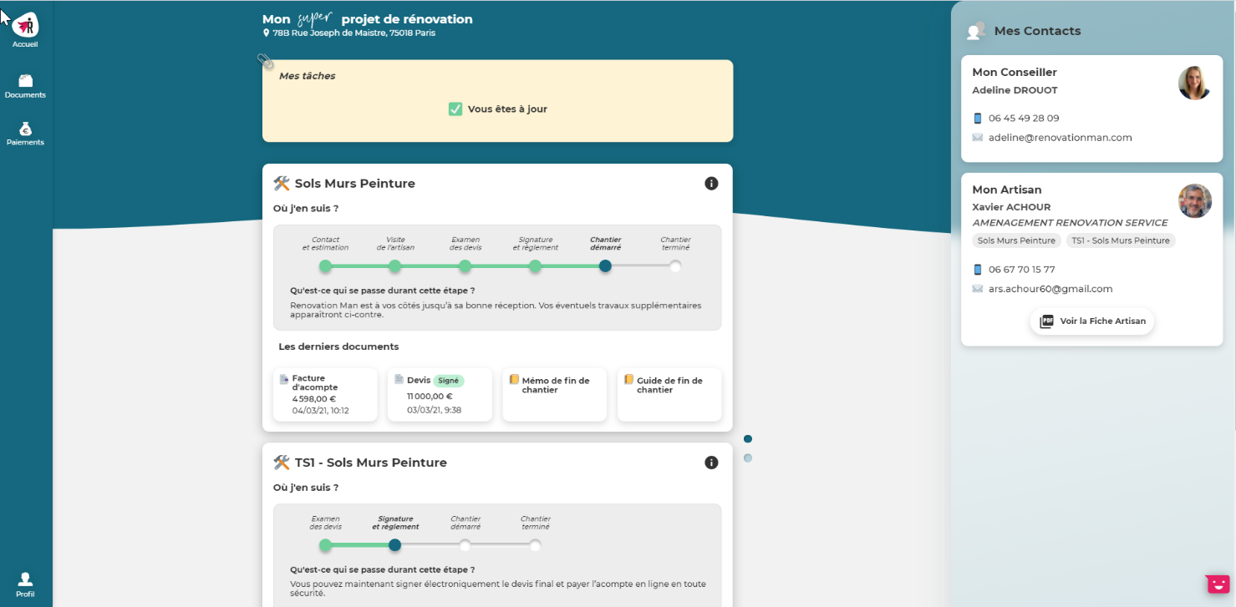
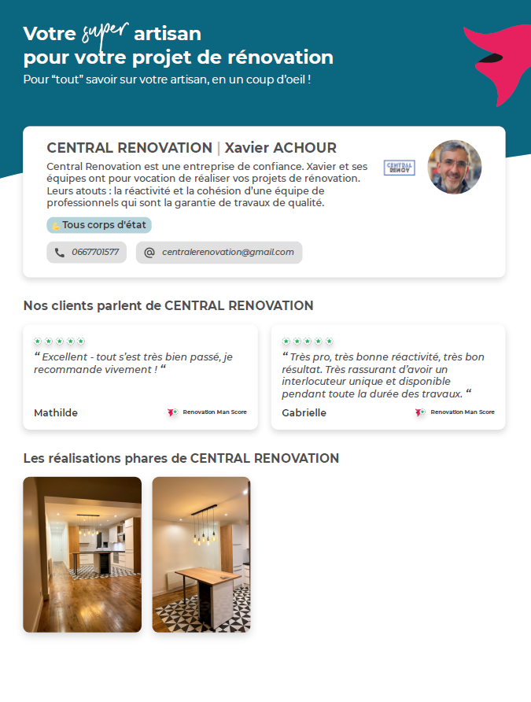
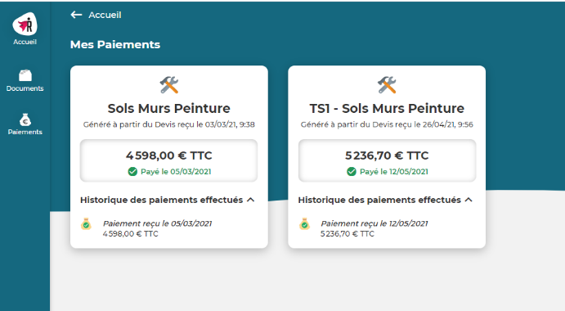
Illustration – Renovation Man: The model of the B2C platform emphasizes on providing services that increase end-customers’ peace-of-mind and satisfaction, notably through an online portal and dedicated customer support
3. Risk #3
Illustration of Renovation Man’s customer portal
Customer dashboard & overview of payments
Craftsman presentation one-pager
Key Take-aways
Renovation Man positions as a trusted third-party to help individuals along their renovation projects, particularly by smoothing the interactions with service providers
To do so, the platform offers an online portal where customers can access key information about their project’s progress, as well as contact their dedicated supervisor
Sources: eleven research and analysis, Information Memorandum

Slide 62






Illustration – Porch: Initially providing a B2C platform to connect homeowners with home improvement services, Porch has developed a SaaS platform for home improvement companies in order to reduce high end-customers acquisition costs
3. Risk #3
Timeline
2013
Creation
2013
$6.3m Seed
2014
$27.6 Serie A
2015
$65m Serie B
2016
Strategy pivot
2020
$21m Serie C
2020
IPO
2020
Acquisition of the insurance Homeowners America inc.
The initial business model was a marketplace to connect homeowners with home improvement service providers
Porch has developed SaaS solutions as ERP and CRM software for home services companies to get access to their customers and sell them:
Insurance comparator
Move coordination
Comparison of internet and TV options
Comparison of bids from pros
Booking of small handyman jobs
…
With this acquisition Porch is willing to enter the home insurance market and therefore offer its clients a wide range of services about home care while leveraging its existing data to ensure a better pricing and underwriting
Key data points (2020)
Business model
Business volume
c. $73.2m in 2020
SaaS
ERP and CRM for home services professionals ensuring:
Repeatable and predictable revenue
Customer retention
High customer LTV
Limited addressable market
Marketplace
Wide range of end-customer services ensuring:
Vast addressable market
High variable acquisition cost
EBITDA
c. $-17.5m in 2020
Number of clients
c. 8,000 companies
A SaaS platorm enabling B2B2C revenue
c. 65% of US homebuyers
M&A acquisitions
9 home services companies acquired since Porch creation
Key Take-aways
In a market dominated by Home Advisor, Porch had to change its business model
Porch chose to address end-users indirectly to bypass high customer acquisition costs
Sources: eleven research and analysis, Porch website

Slide 63





C2C platforms provide both an affordable repair services to individuals and a convenient additional revenue source to jobbers but still struggle to be profitable
3
3. Risk #3
Overview of C2C platforms’ model and limits
Example of players
Nature of intervention
DIY and small punctual repairs
“The average job at Frizbiz amounted to about 100€ to 400 €”
– Former business developer at Frizbiz
Key platform metrics
Rather young: average of 8 years of activity
Rather small: ~40 FTEs
“C2C platforms could be an interesting additional offer for over-the-counter compensation”
– Home Product Manager at Allianz Partners
Business model
Commission (10%-30% commission range) or subscription for jobbers
Value proposition for demand side
Affordable services
Access to a pool of ‘jobbers’, graded by other clients
Insurance provided by platform
“The jobbing platforms address about 5-10% of the €70b home maintenance and renovation market in France through small repairs and short-term jobs”
– Former CMO at Travaux.com
Value proposition for supply side
Convenient jobs
Additional revenue source
“You would need high volumes to have enough trusted reviews on your jobbers. Particularly in the renovation industry where the guarantee of quality is the keystone of our business.”
– CEO at Sedgwick France
Model limits
Many service providers try to bypass the platform fee
Hard to ensure quality service from jobbers
Low profitability
High volume needed to reach profitability
High acquisition cost of jobbers and clients
Many platforms therefore partnered with big companies:
“Stootie went bankrupt by spending too much money on client acquisition, while Frizbiz went out of business by investing too much in recruiting reliable professional jobbers for its Leroy-Merlin partnership”
– Former business developer at Frizbiz
Key Take-aways
In spite of having a multi-billion euros market to address, jobbing platforms struggle to find a profitable business model in an industry where volume is key, leading to many players relying on big retailers to acquire clients
Sources: eleven research and analysis, expert calls, Fédération Française du Bâtiment

Slide 64
The risk of B2C platform positioning as « in-kind » reparation providers remains low since platforms do not match insurance expectations in term of both risk delegation and quality standards
4. Risk #4
Competitive landscape on post-loss management
In-kind compensation
Over-the-counter compensation + On-estimate compensation
Beneficiaries
Demand side
Insurers
Companies (e.g. condominium syndicate)
Individuals
…
Technical solutions providers
Risk #4
Risk: B2C platforms could position as « in-kind » reparation providers for insurances
Assessment: This risk appears improbable as:
B2C platforms do not carry the execution risk while insurance are willing to delegate it
Platforms would struggle to ensure quality standards required by insurances in order to maximize services they provide to clients and minimize churn risk
The nature of the service provided by REN differs from renovation platforms as they not only execute renovation but also manage the customer’s loss from end-to-end
On-demand renovation platforms
Post loss stakeholders
B2C
C2C
Software editors
Expertise companies
REN providers
Large and multi-specialty work
Spot requests and small works
Integrated model
Non-integrated model
…
Interoperable solution
…
…
…
…
…
…
…
Professionals
Supply side
Employed professionals
External professionals
Individuals
Low risk
Medium risk
Sources: eleven research and analysis

Slide 65

Although insurance companies and digital home renovation platforms may have some common interests, it seems that both parties are reluctant to collaborate for post-loss renovation
4. Risk #4
Analysis of insurance companies and digital platforms potential collaboration
Insurers’ key selection criteria
Insurance companies
Digital platforms
Compatibility
Ability to resolve the loss quickly
Importance to react very quickly in the event of a loss
Value proposition relies on easing the matching with service providers
Suffer from the same shortage of craftsmen workforce
Geographical coverage
Looking for global REN providers that have a large coverage notably outside cities
Most platforms operate in a selection of big cities due to high expansion costs
Their strategy is to open big cities rather than completely covering a territory
Quality of the work
Need to deliver the best service to customers
Increased attention to the quality of service due to the sensibility of the loss moment, which can often lead to churn from insured person
Difficulty to supervise the execution inherent to the platform model (in B2C and even more so in C2C)
Digital platforms don’t bear the responsibility of the craftsmen’s execution
Rationalization of the providers
Looking to reduce the number of approved providers to cut down on claim management costs, notably leveraging REN platform providers
Platforms aggregate craftsmen but they are not the service provider, each customer has to contract with partnered renovation company
“Insurers’ NPS for home insurance is already very low. They are careful in the selection of REN providers.”
– Product Manager for Home Insurance at Allianz
“Platforms might be able to do it, but I doubt that they would want that. At Travaux.com we were looking to build a brand and not becoming a service supplier for insurance companies.”
– Former CMO at Travaux.com
Key Take-aways
Insurance companies are looking to rationalize their REN providers, but the low level of control digital platforms have on their independent workforce limits the perspectives of insurers leveraging them
Meanwhile, digital platforms are on a quest to build a brand that can help individuals handle their renovation projects with as little hassle as possible
Sources: eleven research and analysis, expert calls

Slide 66

Indeed, REN players provide a comprehensive range of services from client case creation to work validation, while platforms activities focus on the renovation part, reducing the platform competition threat
4. Risk #4
Comparison of REN players and platforms coverage of REN value chain
REN Service
Client support and damage assessment
Repair
Validation of repair
Case creation
Contact with client
Quotation manage-ment
Selection of craftsman
Repair
Payment handling
Validation of repair
Quality control
Client satisfaction
Excerpts of expert feedbacks
Matching platforms
“Taking responsibility for repairs is a REN player’s job, and that is not something matching platforms offer”
– CEO at Sedgwick France
No interface with insurance companies
Quotation design from client description of damage
Craftsman selection is done by client
Repair is performed without supervision from the platform
Payment management is sometimes supported by platform
Platform services are limited to matching clients with craftsmen
No quality assessment is done after repairs
Renovation support platforms
“These companies are developing a very interesting new service but are still quite small”
– Former CMO at Travaux.com
Thorough quotation design services in a client-focused point of view (form)
Absence of competences to limit costs and negotiate with insurance companies
Craftsmen are carefully selected from a pool of experimented and trusted partners
Repairs and payment are part of the platform’s offer
Lack of infrastructure to handle the closing of client file with insurance
Quality control and client satisfaction are completely supported
REN players
“The added value of REN players is their end-to-end handling of a client file.”
– Product Manager for Home Insurance at Allianz
Client file management and quotation is completely integrated in REN services
REN providers select trusted craftsmen from their network to perform repairs
Payment is managed from insurance to craftsman without client intervention
Client support and quality control are differentiating elements performed by REN players
Key Take-aways
While the platform and REN businesses share common features, the REN business is complex and requires investments to handle client files efficiently from end-to-end
Not covered
Partially covered
Fully covered
Sources: eleven research and analysis

Slide 67













Illustration – Acolad: The robustness of Acolad’s operating model relies on its internal organization and capacity to provide quality service to customers, leveraging project management, sales and matching skills
Acolad as an example of flexible sub-contracting platform
Technological layer
Acolad value proposition:
Acolad brings value by offering a hybrid solution, cheaper than traditional agencies and more project-organized than freelances alone
Transfer of value from traditional agencies and freelances working alone
Opportunities
Through its large pool of freelance translators, Acolad built a flexible sub-contracting platform allowing itself to turn into an asset light structure with increased share of variable costs
Key accounts
Medium-size companies
Clients
Machine translation
Global project & workflow management
Quality assurance
CAT
Acolad’s augmented B2B platform
Front-office (c. 700 FTEs)
Back-office (c. 300 FTEs)
Freelancer network (c. 15,000 freelancers)
Workflow automation
Suppliers
Key Take-aways
Beyond positioning as an intermediary between customers and suppliers, successfully operating a B2B platform requires additional skills in project management, sales (dedicated team handling client interactions) and human-made matching (versus automatically allocating a resource to a client)
Sources: eleven research and analysis

Slide 68

Ultimately the level of guarantees offered by platforms to end-users differ according to each player but remains lower than what REN players are able to commit to, thus playing in favor of REN providers
4. Risk #4
Comparative analysis of guarantees offered to end-users by digital platforms and REN
Prior to the work
Execution
After the work
Guarantee to find a service provider
Check of providers’ administrative documents
Establishment of a contract between provider and individuals
Full responsibility of the execution
Partnership with insurance companies in case of litigations
Compensation in case of non-delivery of the project
Matching platforms:
Renovation support platforms:
Responsibility delegated to craftsmen and covered by their own insurance
Partnership with AXA for legal protection
Guarantee to obtain a building permit
Covering of costs incurred by the abandonment of the project
REN players
TBD
TBD
Key Take-aways
Matching platforms such as Travaux.com offer no guarantee to customers on their partner service providers or the quality of the work delivered
Renovation support platforms like Renovation or Hemea seem to have invested more efforts into protecting their customers, notably through partnership with Axa
Whereas REN players seem to be the only ones able to account for the quality of the work that is delivered, which is a strong competitive advantage allowing to secure their positioning compared to online platforms
Sources: eleven research and analysis
Based on public data

Slide 69
Executive summary
On Hestia’s historical market, new IT tools have appeared to facilitate the collaboration between all stakeholders
Beyond these tools, platform business models have appeared, representing both risks and new business opportunities for Hestia
Assessment of platform risks for Hestia
On this market, different growth opportunities could be addressed by Hestia leveraging Frizbiz
1
Outside-in assessment of internal digital projects
2
AGENDA
Risk/opportunity analysis of platform business models
3
Appendix
4

Slide 70

Frizbiz opportunity - Hestia could leverage Frizbiz acquisition both to increase its productive capacity and to create new services and business opportunities
Increase Hestia’s productive capacity
Create new business opportunities
1
2
3
4
5
Target
Frizbiz as a digital enabler
Frizbiz as a privileged subcontractor of Hestia
Frizbiz as a “digital REN agency”
Frizbiz as a B2B2C platform
Frizbiz standalone
Hestia leverages Frizbiz assets:
A platform to centralize and manage its workforce
A digital and IT team as c. 70% of Frizbiz workforce are developers
Hestia leverages Frizbiz worker pool to find qualified workers in the context of workforce shortage
Hestia provides insurance with a “digital agency”: a B2B platform (relying on premium Frizbiz network) that acts as a REN provider
Hestia provides insurance with a B2B2C platform (potentially white label) to offer their insured client a selection of renovation providers in the context of “over-the-counter” or “on-estimate” compensation
Hestia keeps Frizbiz as a standalone platform and tries to scale it
Rationale
N.A.
From €6.4m revenue in 2021 to €19.9m in 2025
The digital agency is expected to growth from €0.7m in 2021 to €7.4m in 2025
The B2B2C platform has not been integrated in the BP
From €0.6m revenue in 2021 to €0.7m in 2025
BP
Key Take-aways
Frizbiz is expected to provide Hestia with an additional workforce either for its IT and technological development or for subcontracting
Frzibiz is also expected to support Hestia in the creation of new services and business opportunities:
Create a fully digital REN agency for insurances
Enter “over-the-counter” and “on estimate” markets with the launch of platforms that enable end-clients to find home services providers
Sources: eleven research and analysis, Hestia’s VDD, Hestia’s IM

Slide 71
Frizbiz opportunity - While Frizbiz should enable Hestia to increase its productive capacity, the launch of new services would be more complex and should be investigated further
Increase Hestia’s productive capacity
Create new business opportunities
1
2
3
4
5
Target
Frizbiz as a digital enabler
Frizbiz as a privileged subcontractor of Hestia
Frizbiz as a “digital REN agency”
Frizbiz as a B2B2C platform
Frizbiz standalone
Risk assessment
eleven’s point of view
Hestia could benefit of the IT solutions and infrastructure of a digital native company
Hestia could leverage Frizbiz “start-up spirit” to attract tech talents
Require significant workers recruitment and therefore high acquisition costs
The exact model needs to be further analyzed (risk allocation, insurer vs platform branding, …)
The C2C services platform market is a very competitive market, and the model has yet not reach profitability
Hestia could leverage Frizbiz best talents to subcontract
Potential risk on service quality
The REN requires a full mgt of claim far from Frizbiz activities
Rationale
“70% of Frizbiz staff are developers”
– Former business developer at Frizbiz
“There is a global craftsmen shortage: they are often both on B2B platform and in REN networks”
– Home product manager at Allianz partner
“Insurance wants REN players to handle the whole claim”
– Home product manager at Allianz partner
“The provision by the insurance company of a platform to carry out its complementary work is a good way to bring more services to its customers”
– Home product manager at Allianz partner
Further DD assessment
In depth assessment of the platform & teams, side-by-side analysis with other Hestia tools
What is the worker pool depth and quality?
Do the craftsmen selection process ensure the work quality?
How to ensure marginal profitability?
Are theses opportunities cheaper than using a subcontractor ?
What will be the model of such a platform?
Who would carry the execution risk?
How to ensure the service quality?
High opportunity
Medium opportunity
Weak opportunity
TBD
Sources: eleven research and analysis, Hestia’s VDD, Hestia’s IM

Slide 72
Business case – opportunities 2&3 – Optimistic scenario
Highly preliminary - to be refined with actual data
Evolution of « marge chantier » and craftsmen acquisition costs (in €m)
Evolution of “marge chantier” (2021-2025, in €m)
Comments
Optimistic hypotheses:
1.5 craftsmen working per worksite
500€ acquisition cost per craftsman
4 worksites per craftsman per year on Frizbiz
20% craftsmen churn per year
Frizbiz has 300 premium workers as of 2020
Evolution of acquisition costs (2021-2025, in €m)
Key Take-aways
In the optimistic scenario the activity increase compensates large acquisitions costs and enables Frizbiz to reach the financial balance
This scenario would require a strong ability to retain craftsmen on the platform and to engage them on multiple projects per year and therefore to establish Frizbiz as a reliable partner

Slide 73
Business case – opportunities 2&3 – Pessimistic scenario
Highly preliminary - to be refined with actual data
Evolution of « marge chantier » and craftsmen acquisition costs (in €m)
Evolution of “marge chantier” (2021-2025, in €m)
Comments
Optimistic hypotheses:
1.5 craftsmen working per worksite
800€ acquisition cost per craftsman
3 worksites per craftsman per year on Frizbiz
30% craftsmen churn per year
Frizbiz has 300 premium workers as of 2020
Evolution of acquisition costs (2021-2025, in €m)
Key Take-aways
In the pessimistic scenario the activity increase induces large acquisitions costs that prevent Frizbiz from reaching the financial balance
This scenario is supported by the strong workforce shortage, the high acquisition costs observed in other industries (e.g. lawyer platform…) and the difficulty to retain workers in a platform model

Slide 74
Executive summary
1
Outside-in assessment of internal digital projects
2
AGENDA
Risk/opportunity analysis of platform business models
3
Appendix
5

Slide 75

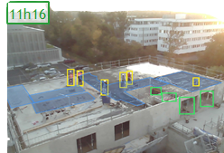
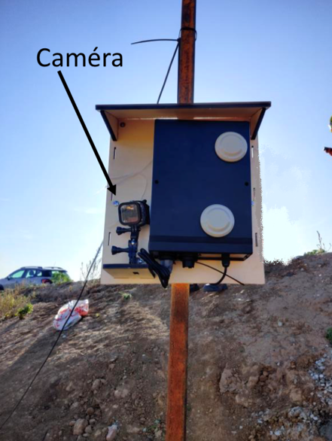
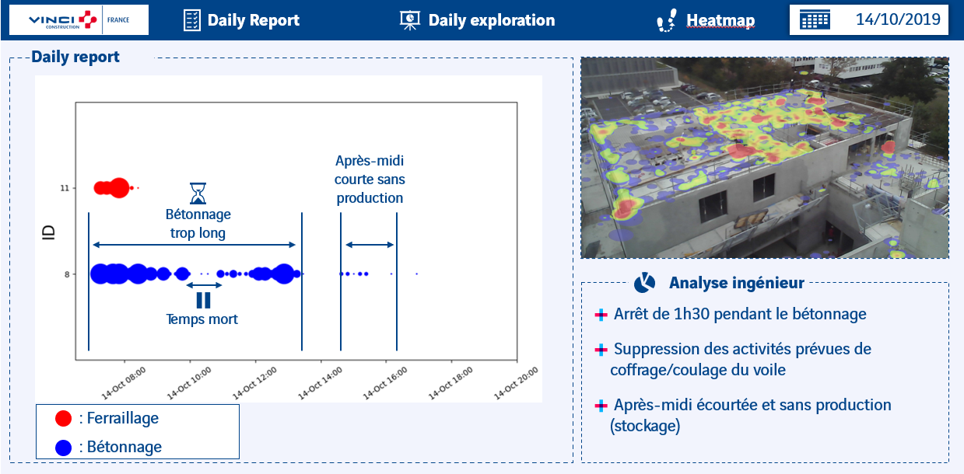
Illustration: Solutions for monitoring progress and optimizing site productivity are also being developed based on the collection and analysis of video images
Operations
Computer vision
Example of similar initiative
Chronsite: Solution to automate time analysis (time tracking of jobsite tasks) using image analysis and business knowledge
Collection of site’s information
Image analysis using algorithms and business knowledge
Restitution of business indicators and presentation of action levers
Installation of cameras in strategic locations, capturing images of the work site every minute
Sending and storing captured information in a secure database via 4G
Use of captured images with automatic detection algorithms for objects, structures and operators
Use of business knowledge to create concrete productivity indicators to be identified
Restitution of indicators (duration of tasks, number of workers mobilized...) and visualizations for each project
Highlighting of potential improvements (unnecessary movements, risky situations...)
Updating of the macro planning of the site
Cameras placed on the construction site to collect images
Example of camera image analysis
Web platform for visualizing indicators
Impact
Generalization of chrono-analysis on sites at a lower cost
Continuous improvement of the productivity of the building sites of about 3% on average
Sources: eleven research and analysis
Sources: https://leonard.vinci.com/la-massification-de-la-chrono-analyse/

Slide 76

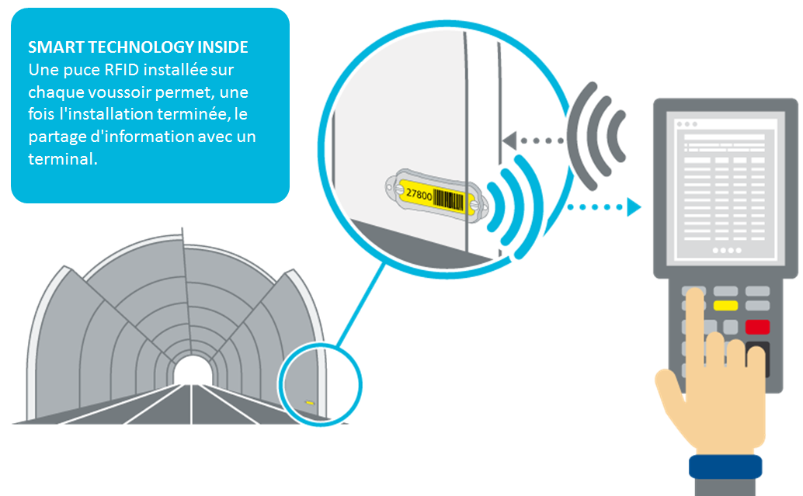
Illustration: Solutions for providing proof of passage based on the scanning of an RFID / QR code tag associated with the equipment have been developed on the market
Operations
Proof of passage
Example of similar initiative
Product identification via the integration of an RFID chip and the storage of associated data - Consolis
Smart Technology inside: integration of an RFID chip into the segment at the time of manufacture
Bidirectional communication: a device activates the wireless connections and connects to the RFID tag
Unlimited access to information: the software presents the data stored in the tag: manufacturing, quality control, part numbers
Sources: eleven research and analysis
Sources: recherches et analyses eleven

Slide 77

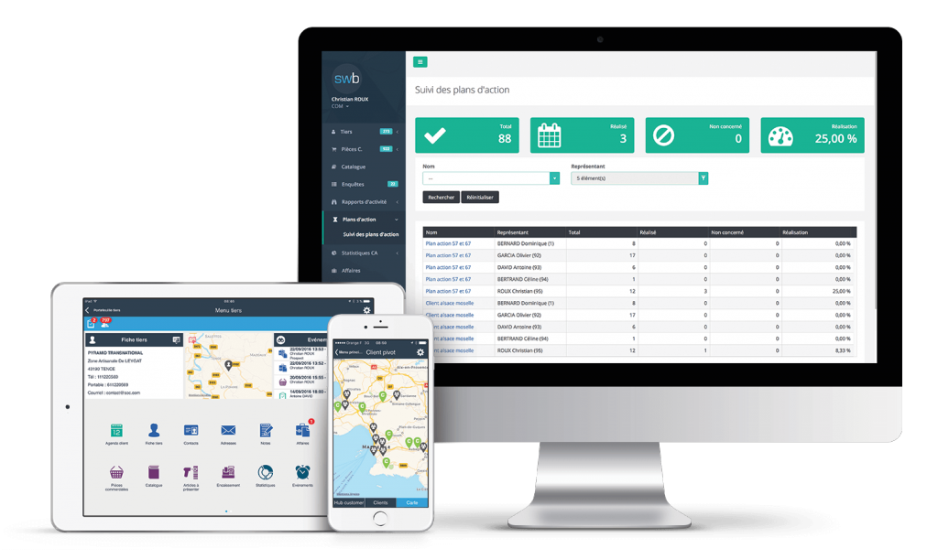
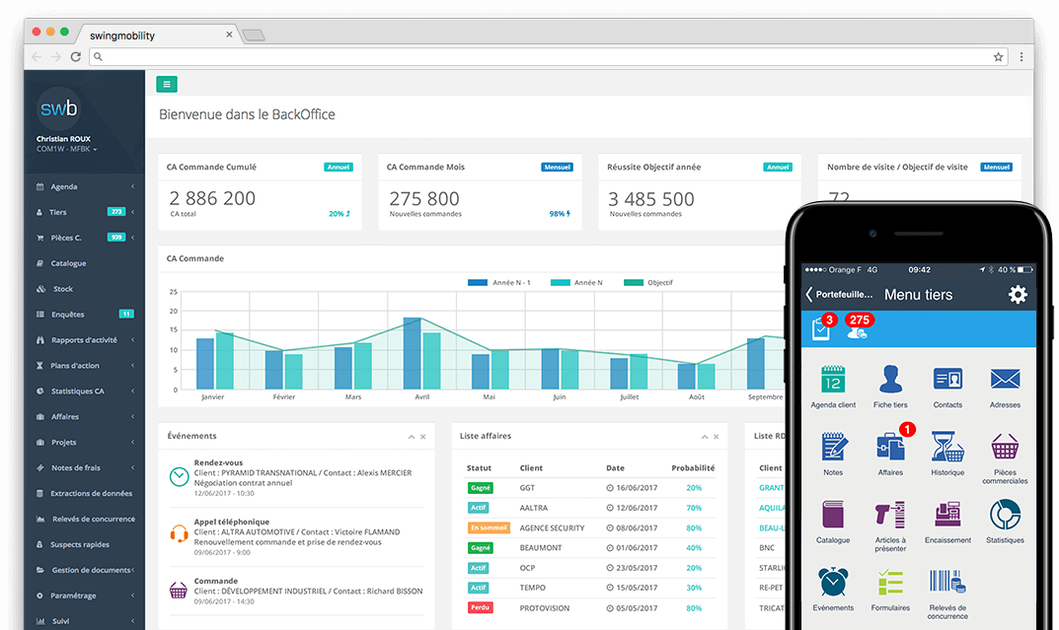
Illustration: CRM solutions exist to monitor sales promotion and encourage cross-selling
Client-facing
Cross-sell
Example of similar initiative
Mobile CRM: CRM as a web or mobile application - Swingmobility
Multi-device CRM allowing the salesperson to use it even during customer meetings
Dashboard for monitoring ongoing contracts or prospects
Data exchange with the ERP in offline mode
Detection of opportunities thanks to an analysis of the customer's purchase history in order to renew a contract or to make cross-sell
Sources: eleven research and analysis

Slide 78
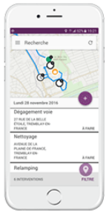
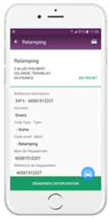
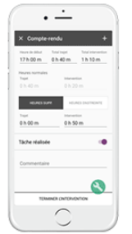
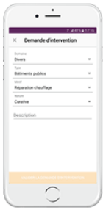
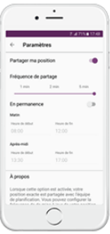
Illustration: Technician / craftsmen mobile app
Example of similar initiative
Multi-device and ergonomic application facilitating interventions in the field - Majik'Mobile
Before intervention
During and after intervention
Consultation of the roadmap and the intervention rounds
Viewing the route sheet
View the schedule for the day, week or month,
Display of the schedule in list or map mode
Intervention form
Viewing the schedule in list and map mode
Status update
Filling out reports
Request for additional intervention
Geolocation and navigation assistance
Sharing of the location can be configured according to time slots
Launch of GPS guidance
Workflow for processing interventions
Customization of the life cycle of an intervention order according to business needs
Update of intervention status (in progress/finalized/inax)
Reports and capture of intervention times
Automatic capture of travel and intervention times
Text or voice input of reports
Addition of photos/videos
Information feedback at the initiative of field agents
Writing of a report for an unplanned intervention
Transmission of a complementary intervention request
Setting up location sharing
Sources: eleven research and analysis

Slide 79
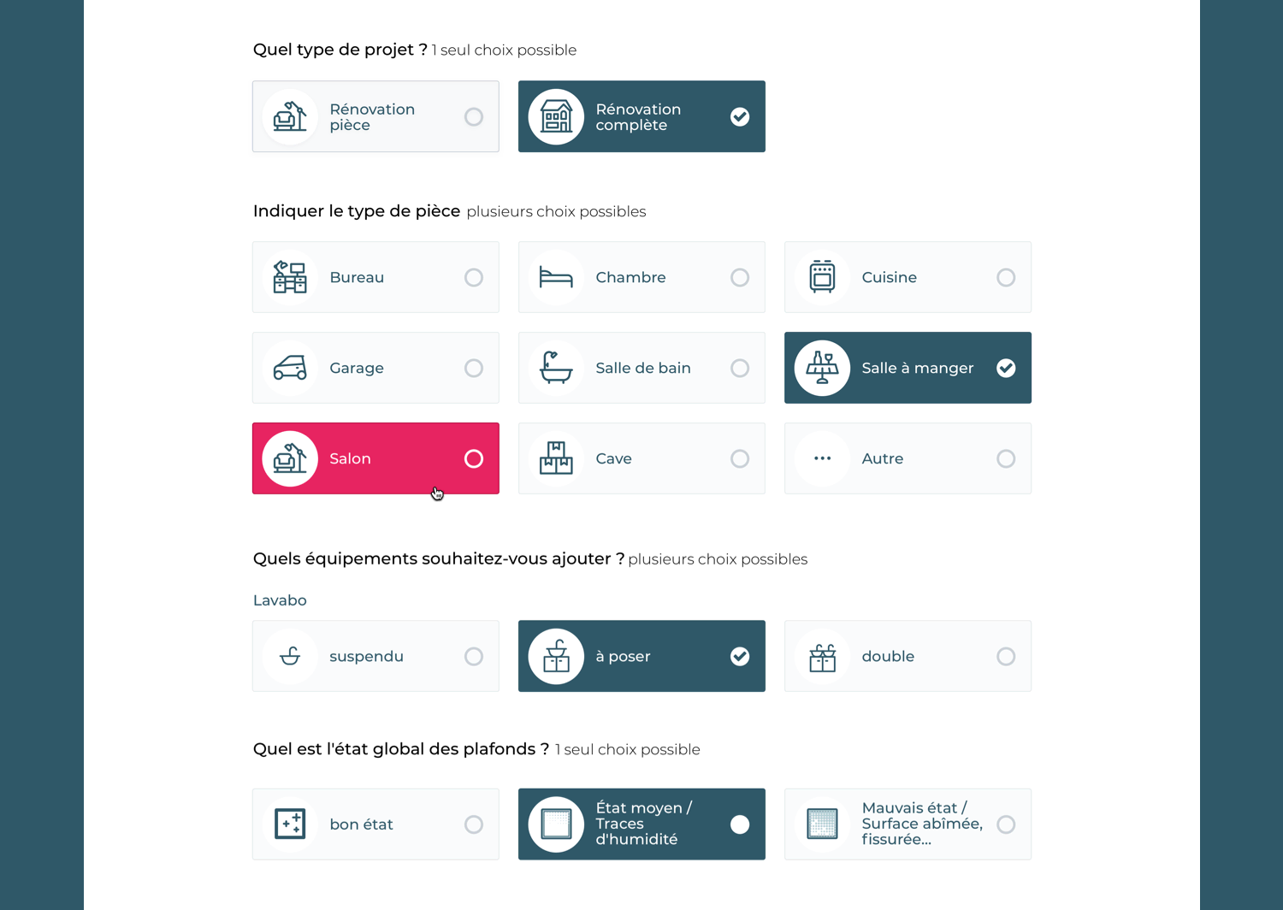
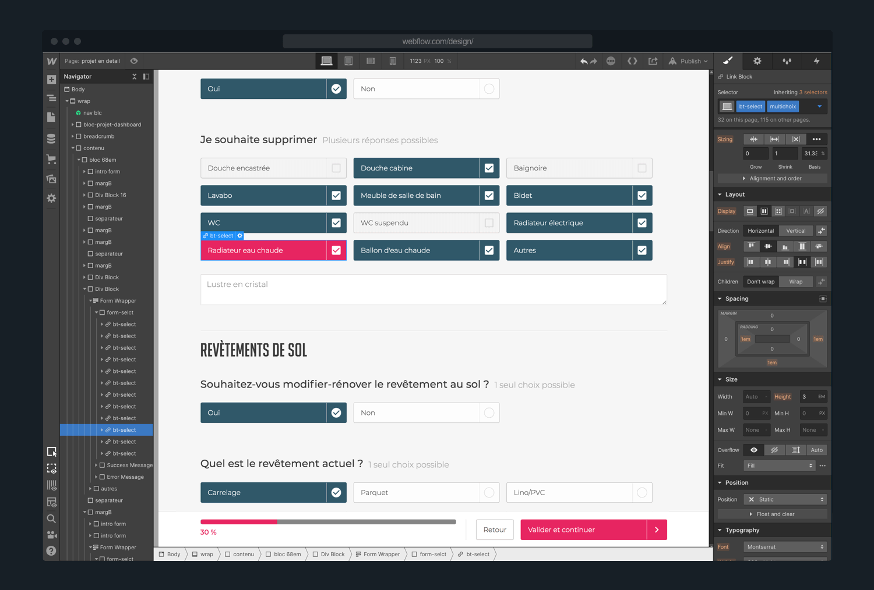
Illustration: Renovation Man has developed a quotation tool allowing to describe their renovation projects and size it
Snapshots of Renovation Man’s online quotation tool for individuals
Sources: eleven research and analysis

Slide 80
Project Hestia
Thank you

